Slide 1
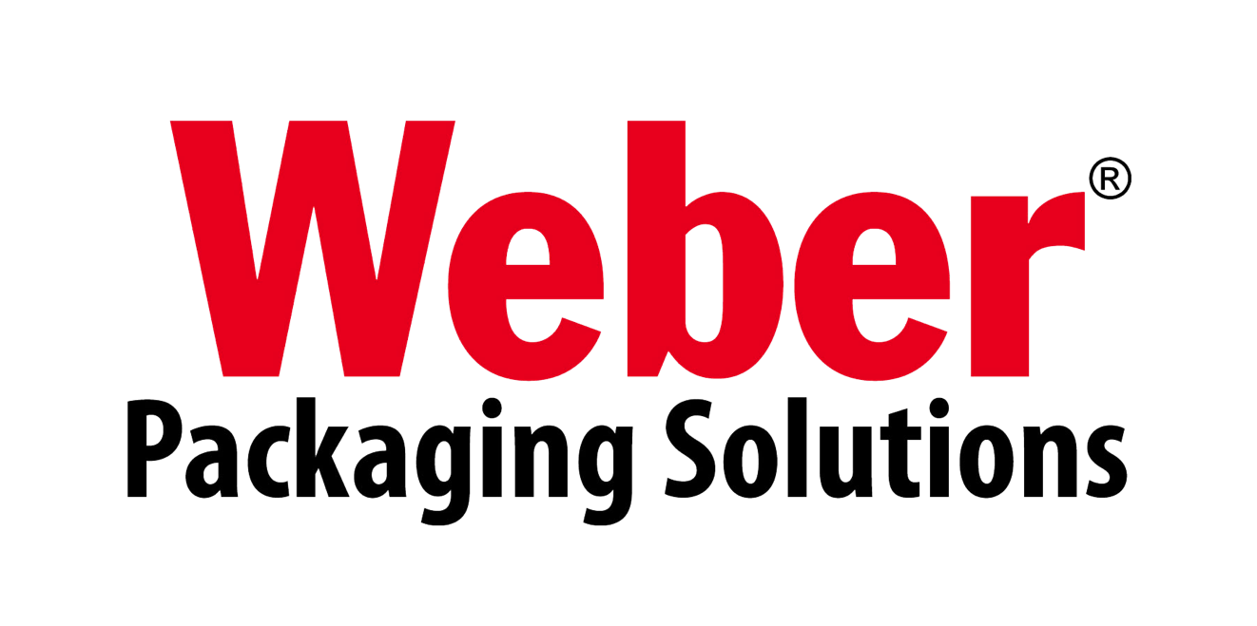
Innovations in Labeling & Coding Solutions
+032459733

Slide 2
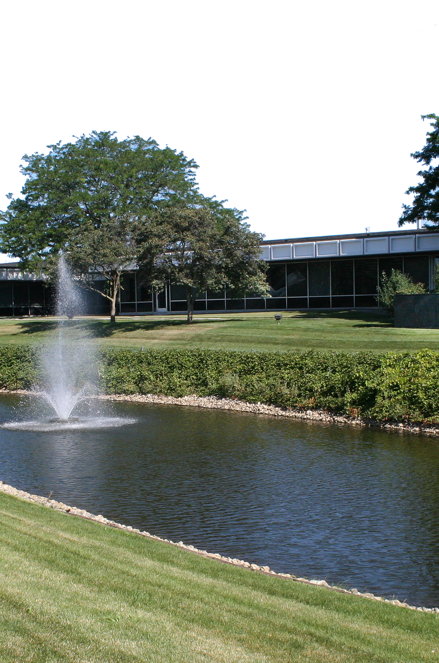
About Weber
A leader in the packaging world for over 90 years.
Labels
Weber prints millions of labels annually for food, beverage, life sciences, chemical industries and more.
Labeling Systems
Weber designs & manufactures a wide range of label applicators and print-apply systems.
Ink Jet Systems
Our Thermal ink jet coders are reliable, easy-to-use, and economical to run.
Nationwide Service
Our direct service team will work with you to keep your equipment operating at optimum efficiency.
www.weber.co.uk
Weber Packaging Solutions
Arlington Heights, Illinois, World Headquarters
+032459733

Slide 3
Worldwide Weber
Providing global coverage for innovative labeling and coding products.
Canada
Weber Marking
Systems Canada
Germany
Weber Marking Systems GmbH
USA
Weber Packaging
Solutions
Ireland
& UK
Weber Packaging Solutions UK & Ireland
Thailand
Weber Marking Systems Thailand
Australia
Peacock Bros. Pty.
Weber manufacturing facilities worldwide

Slide 4












Our Valued Clients
Providing Innovative Labelling Solutions to Global Companies
Canada
Weber Packaging UK
Weber Marking Thailand

Slide 5
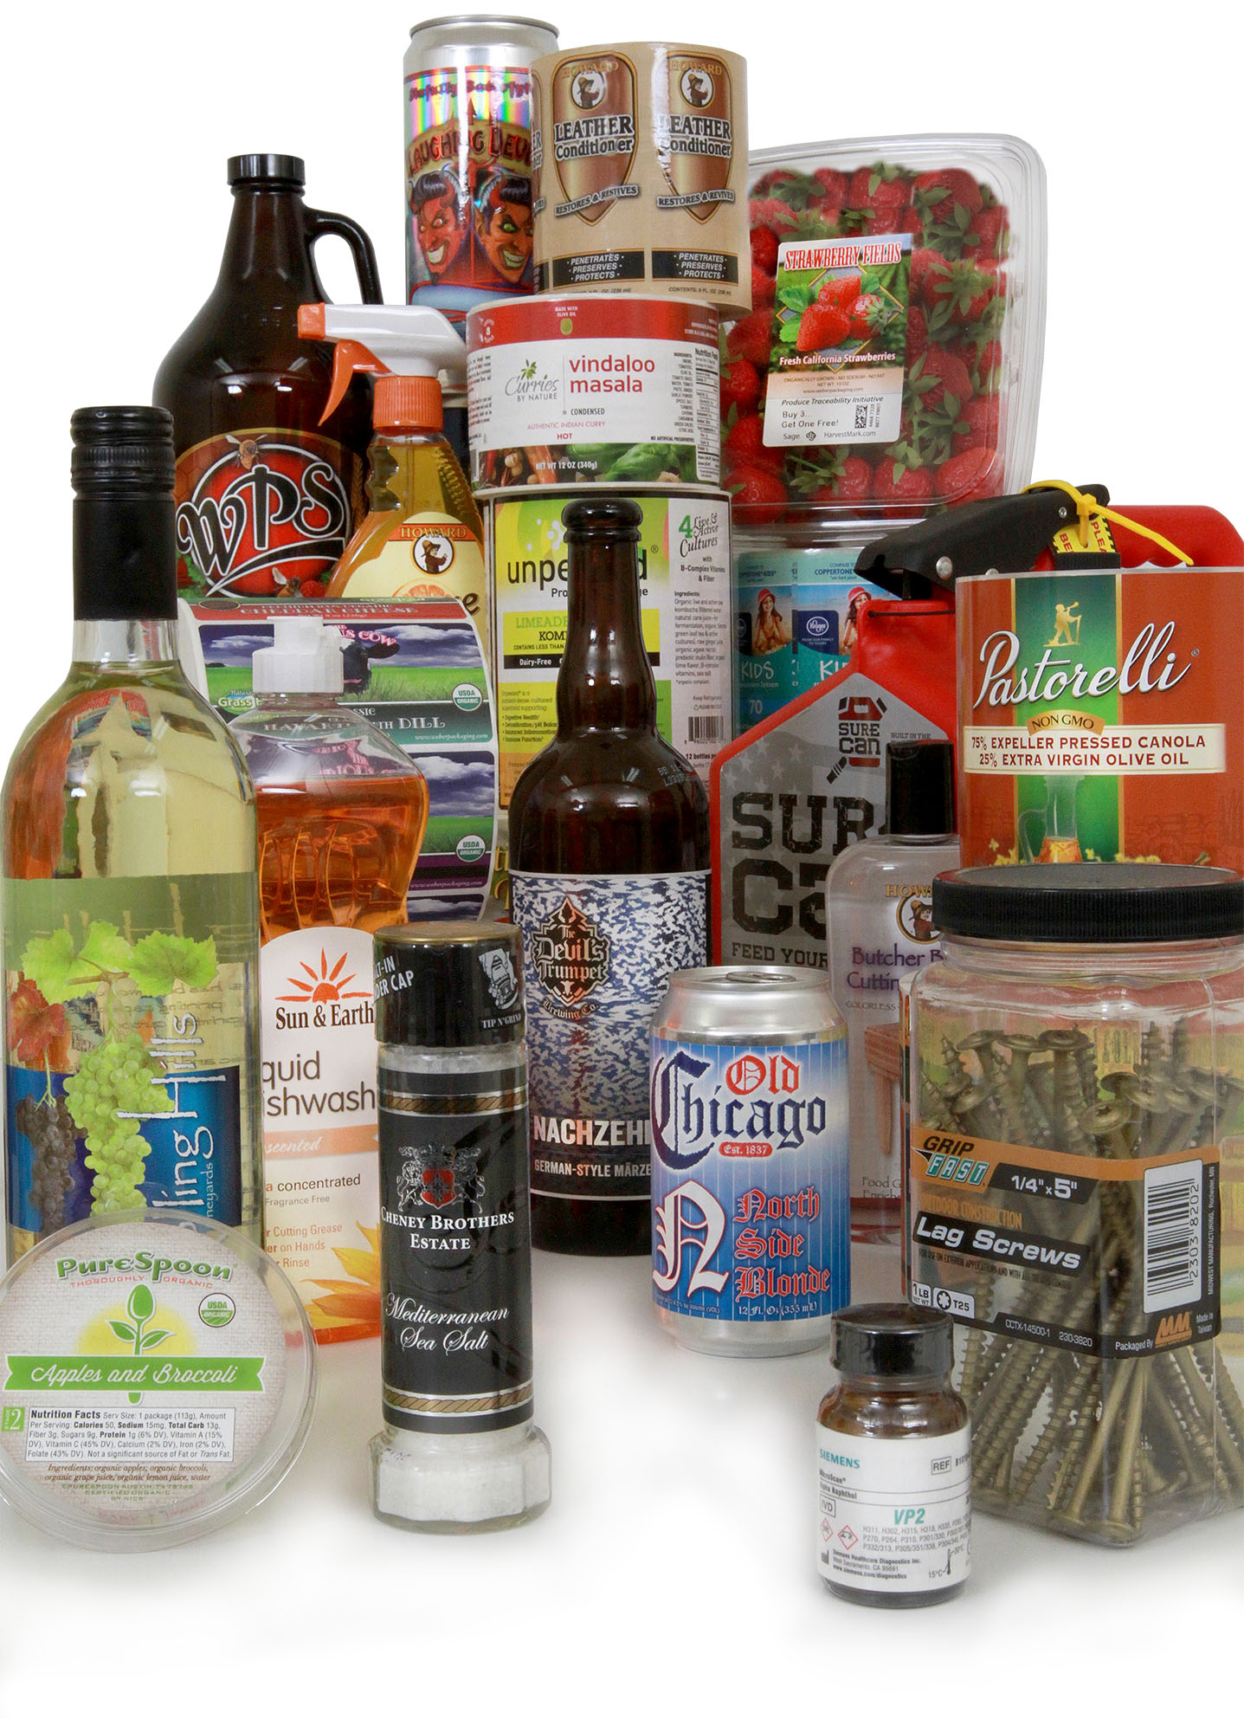
Labels
Custom labels, blank labels, RFID labels & more
Weber Labels
Weber Packaging Solutions manufacture a very broad line of labels and tags at our 20,000-square-foot manufacturing facility.
With over 10 Mark Andy flexographic and digital label presses under one roof, we are able to select the most productive printing technology for a particular order. These high-speed presses print labels up to ten colors, including services such as laminating and embossing
Weber also offers over one hundred combinations of paper and film label stocks partnered with numerous adhesives to create labels that can be perfectly matched to a specific application.
Weber Packaging Solutions
Custom Labels for any market or category.
+032459733

Slide 6
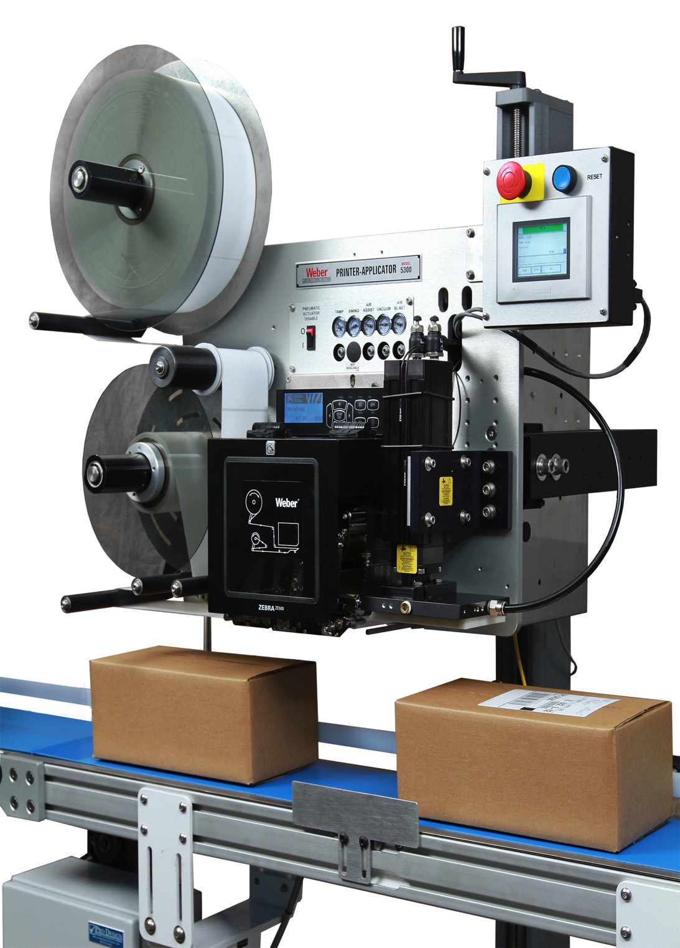
Labeling Systems
Label Printer-Applicators
Weber Print-Apply Systems
Weber manufacture and design a variety of label printer-applicators to fit every industry and application. We can customize a system to fit into your current production line or act as a stand-alone unit for semi-automatic feeding.
The major benefits of print-apply systems include their ability to:
• Eliminate the expense & inconvenience of preprinted labels
• Eliminate label obsolescence
• Reduce labor costs
• Provide faster, more accurate labeling
These sturdy, self-contained units combine a high-density thermal/thermal-transfer label printer with an automatic label applicator to simultaneously print and apply pressure-sensitive labels to the top, bottom or side of products along the conveyor line.
Weber Packaging Solutions
Reliable labeling systems built to last.
+032459733

Slide 7
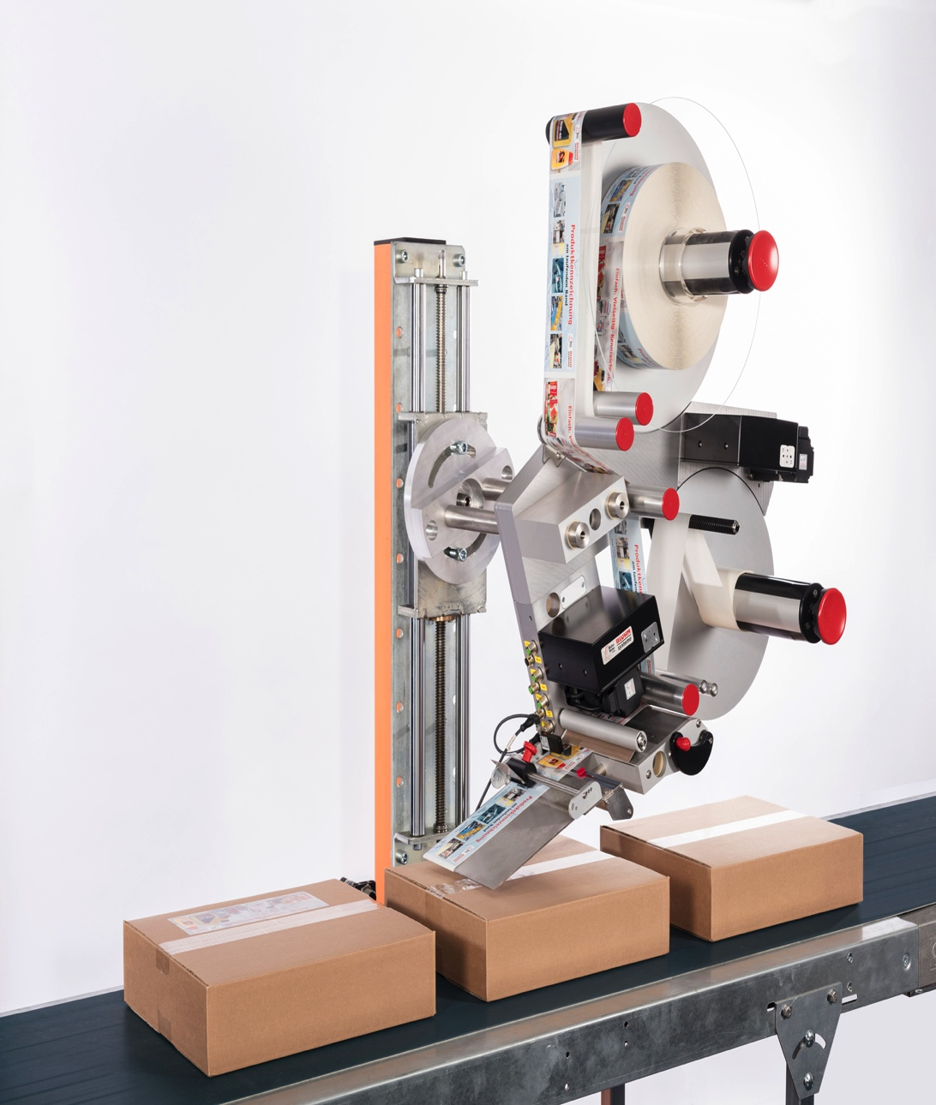
Labeling Systems
Label Applicators
Weber Label Application Systems
Weber offer a complete line of automatic label applicators that can rapidly apply preprinted pressure-sensitive labels to all types of products and packages.
• High-speed application rates programmable up to 6,000
linear inches of label web/min.
• Advanced stepper-motor or servo-motor technology and
peel-tip sensing
• Gentle-contact (wipe-on) or non-contact (tamp-blow or
air-blow) methods of application
• Exceptional placement accuracy to ±0.03”
• Easy maintenance and unsupervised operation functions
• Low-volume and hand-apply systems for economical
labeling
Weber Packaging Solutions
Accurate, high-speed labeling.
+032459733

Slide 8
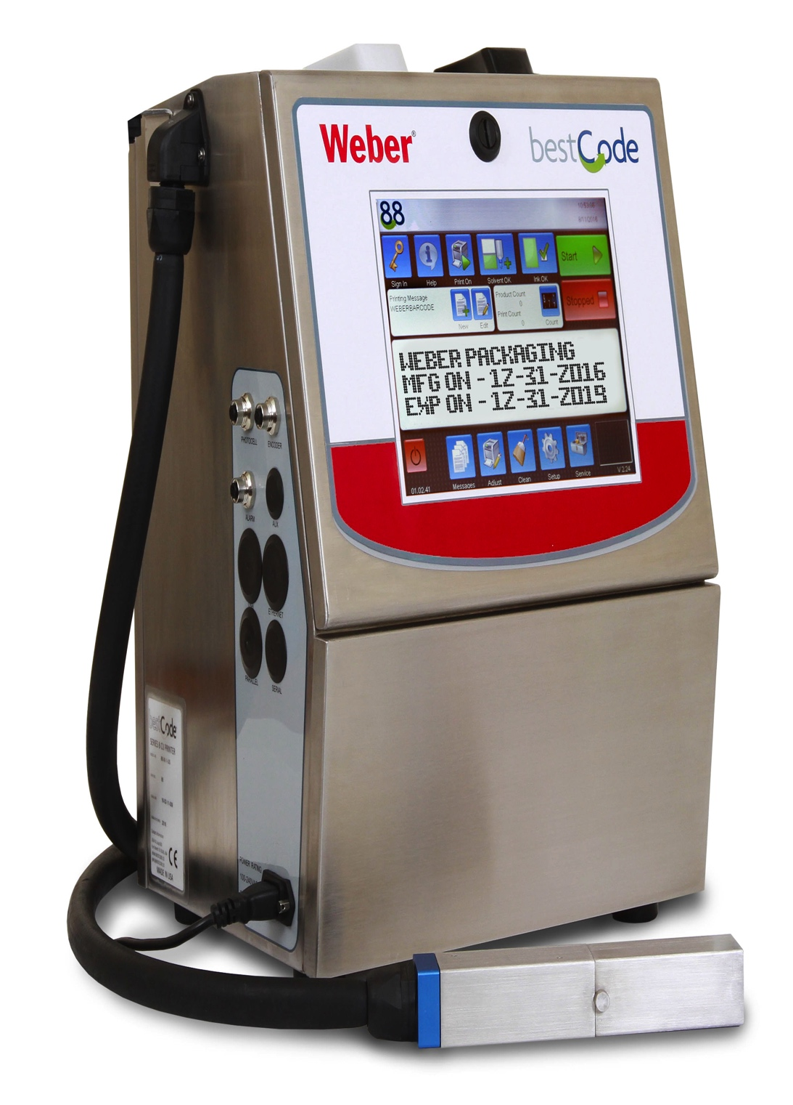
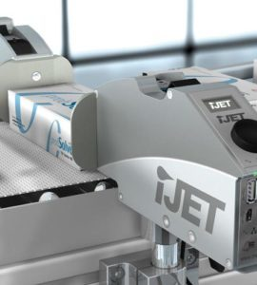
Ink Jet Systems
Reliable Ink Jet Coders
Weber TIJ Coders
Weber’s Industrial Marking and Coding Systems print high resolution date codes, lot codes, 2D Barcodes and other identifying marks and codes on industrial and consumer goods to ensure product traceability.
Under our Markoprint Brand we provide a complete range of small character printing systems that print high-speed, reliable marks and codes on a wide range of substrates including plastic, glass, paper and more.
A wide selection of models are available to fit your application, from high-speed multi-line coders to the entry-level economically-priced X1 Jet System.
Weber Packaging Solutions
A wide range of Thermal ink jet solutions.
+032459733

Slide 9
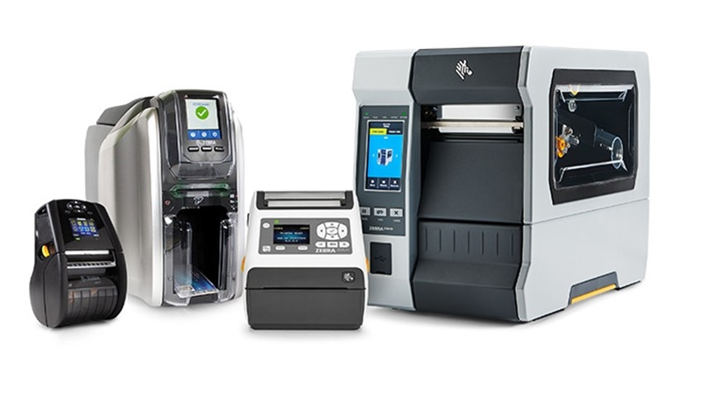
Desktop Printers
Barcode Printing Solutions
Weber Desktop / Mobile Printer Solutions
Weber supply a wide range of Barcode Label and Tag Printers from Industry Leaders such as Zebra, Sato, and TSC. We can supply a wide range of solutions from narrow web tag and wristband printers for patient ID care to wider web printers for logistics and manufacturing.
Our industrial printers are designed for harsh and demanding environments. With rugged durability and future-proof adaptability, our user-friendly barcode label and RFID printers are designed to provide 24/7 reliability and ideal for your high- to mid-volume applications.
A wide selection of models are available to fit your application, including bespoke Semi Automatic Label Applications.
Weber Packaging Solutions
A wide range of Barcode Printing Solutions.
+032459733

Slide 10
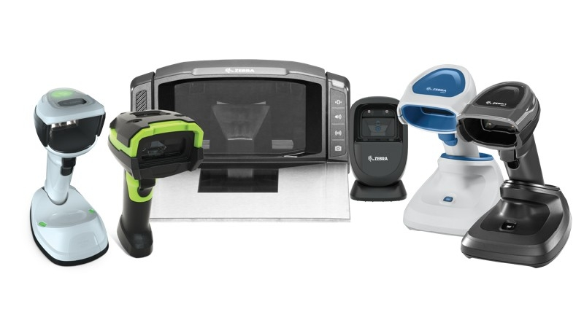
Barcode Scanners
Barcode Printing Solutions
Weber Desktop / Mobile Data Capture Solutions
Weber supply a wide range of Barcode Scanners and mobile Data Capture Devices from Industry Leaders such as Zebra, Datalogic, and Sick. We can supply a wide range of solutions from desktop based scanning kiosks to mobile and wireless Handheld Barcode Scanning Solutions.
Our industrial scanners are designed for harsh and demanding environments and can be used with a suite of software, apps and utilities to accelerate productivity and improve decision making in your organisation.
In conjunction with our Industrial Automatic Labelling Systems we provide an Industrial Range of Scanners for automatic identification of Products and Barcode Scanning at the point of Label Application.
Weber Packaging Solutions
A wide range of Barcode Printing Solutions.
+032459733

Slide 11
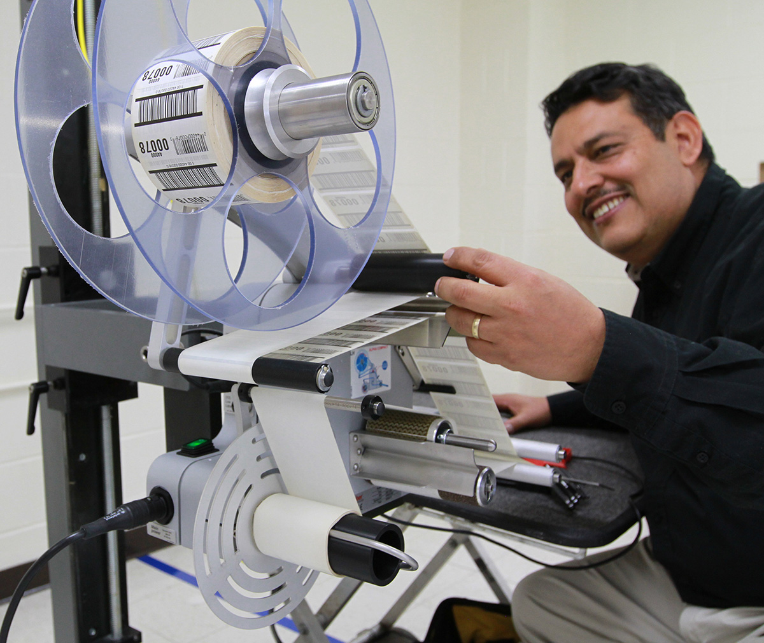

Service & Support
Get the help you need fast.
Weber Customer Service
In addition to a direct account representative there is an experienced team of customer service advisors at our HQ waiting to assist you. They are equipped with the latest real-time, order-entry systems to promptly handle your requests.
Our goal is to assure that every customer always finds it a pleasure to do business with Weber. In a recent survey, Weber clients rated our customer service representatives as being among the best at providing fast and friendly service.
Our Weber Service Team makes it easy to buy labeling systems replacement parts or schedule service for your equipment. Our nationwide direct service organization will work with you to keep your Weber labeling systems operating at peak efficiency. These specially trained Service Technicians are available for immediate technical service through our Central Dispatch center.
Weber Packaging Solutions
Nationwide direct service organization.
+032459733

Slide 12
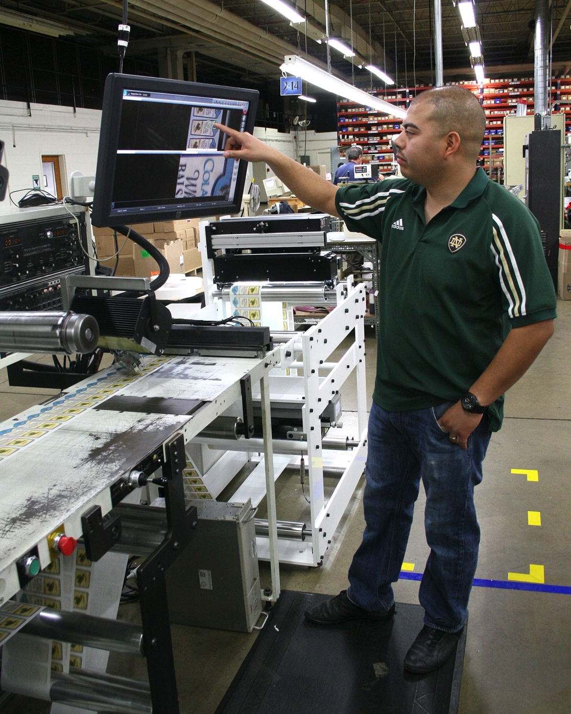
Quality Assurance
Automated label inspection.
Weber Product Quality
Our Quality Assurance team consists of experienced technicians who inspect all raw materials upon arrival, work in progress, and completed label orders to ensure every product we deliver meets our standards and the requirements of the customer.
Weber uses vision inspection systems for their high-speed label quality testing. These units allow us to discover intermittent defects that simply cannot be detected by standard label inspection techniques.
Our processes are certified to meet the stringent requirements of the international ISO9001:2015 quality
standards.
Customer questions and comments are always welcome, and we conduct an annual customer satisfaction survey to assess our performance and to identify opportunities for improvement.
Weber Packaging Solutions
Corporate-wide continuous improvement.
+032459733

Slide 13

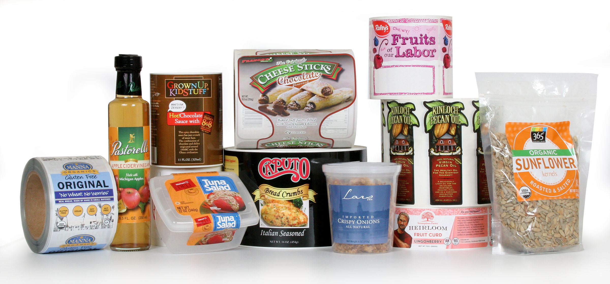
Food & Beverage Labels
Eye-catching labels for your brand.
Weber Food & Beverage Labels
A good-looking pressure-sensitive label on your package gives you the flexibility to tell your story and to entice customers to try your product.
Walk down the aisle of just about any major food store and you will see labels printed by Weber. We have created labels for all types of food packaging including clamshells, bottles, jars, boxes and more. We offer a wide selection of prime label facestocks, adhesives, and topcoats to create the perfect prime label for your product
Weber Packaging Solutions
Make your brand stand out from the crowd.
+032459733

Slide 14

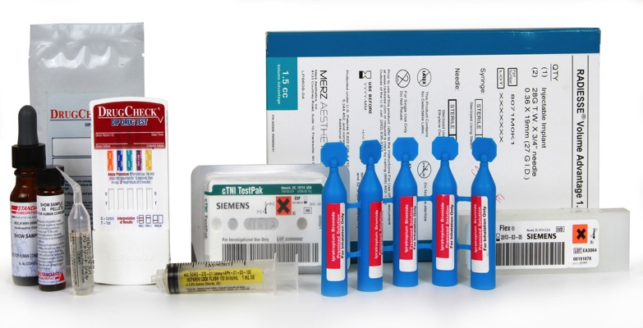
Life Sciences Labels
Eye-catching labels for your brand.
Weber Life Sciences Labels
Weber's extensive knowledge of label materials helps us get the right adhesive & facestock for your label. And we have creative solutions to the many problems faced by healthcare companies that include custom die cuts, complex build and more.
On-press, variable code-dating and messaging using laser etch or UV inkjet allows you to add additional information on the fly. And sequential back-of-liner numbering aids inventory control.
Weber uses on-press and post-press video inspection to maintain the highest quality assurance. We use ISO 9001-registered label manufacturing processes that can assist cGMP compliance to 21 CFR Subpart G.
Weber Packaging Solutions
High-quality, thoroughly inspected and secure
+032459733

Slide 15
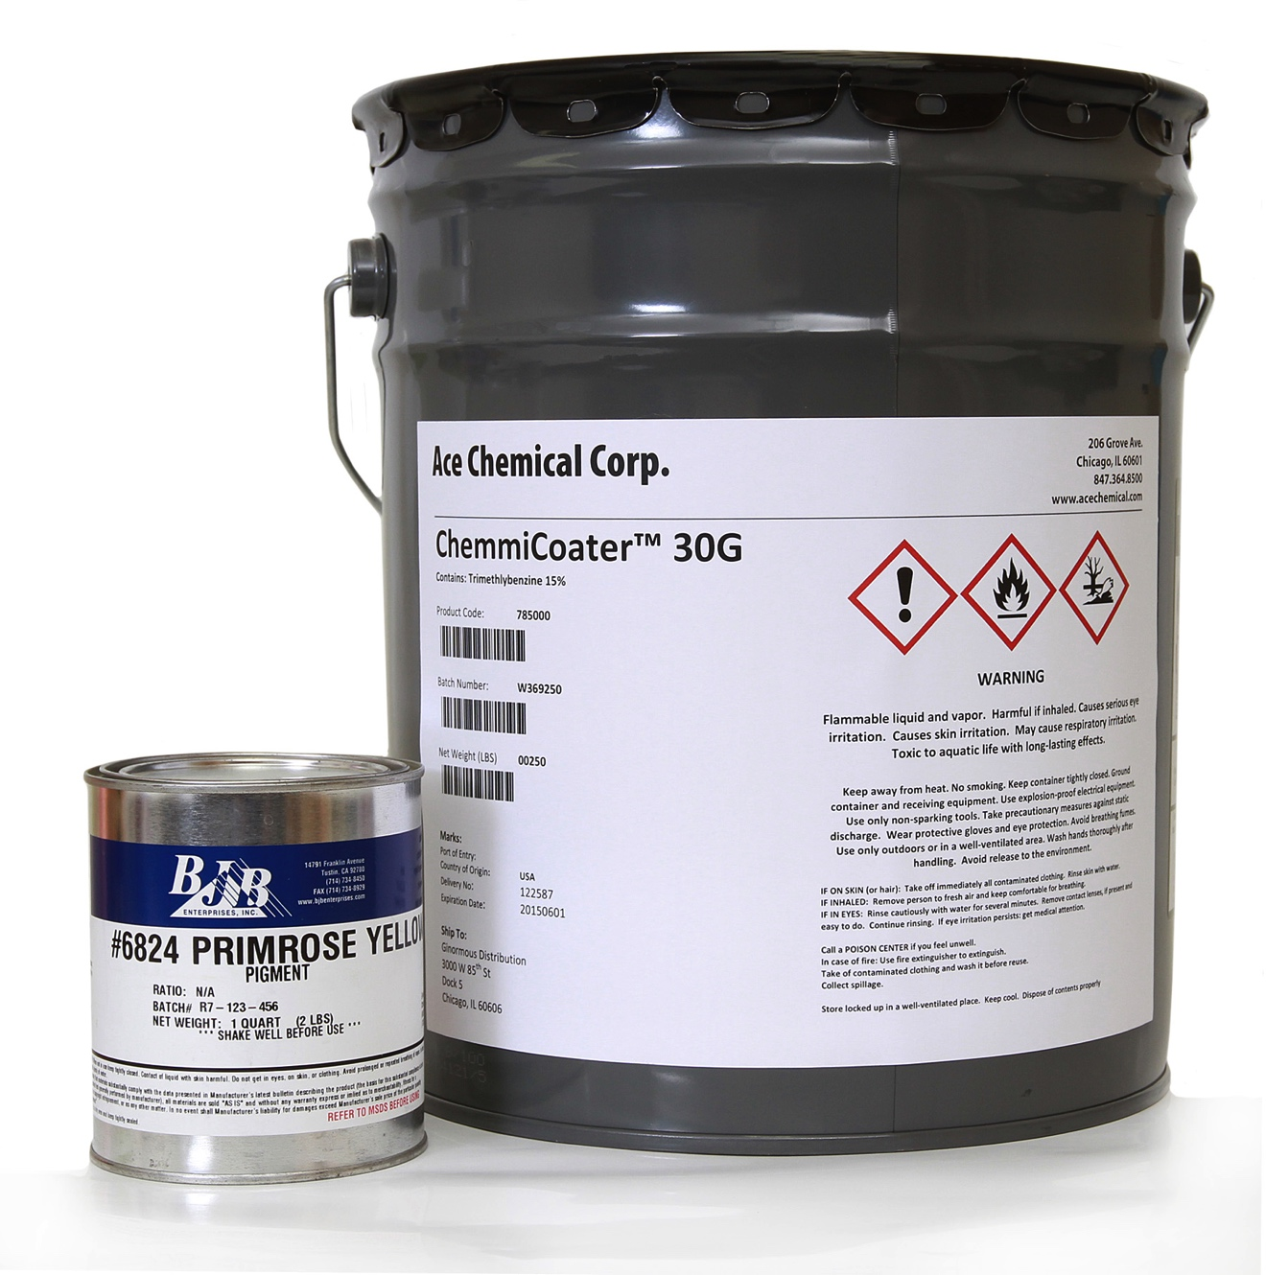
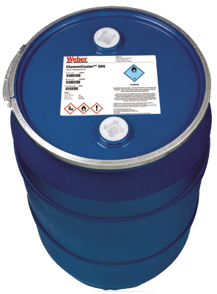
Chemical & GHS Labels
Helping meet your chemical labeling requirements
Weber Chemical & GHS Labels
Weber has the special adhesive-coated, high performance film labels to meet your chemical drum and pail labeling needs. Plus we have labels that meet GHS and BS-5609 compliance standards and drum reconditioning procedures.
When you are printing label in-house, make sure you use the right chemical-resistant variable-imprint label materials that are compatible with direct-thermal, thermal-transfer and inkjet print technologies. We can help you make the right label choices as well as guide you in choosing the best printer for your application.
Weber Packaging Solutions
High-quality, thoroughly inspected and secure
+032459733

Slide 16
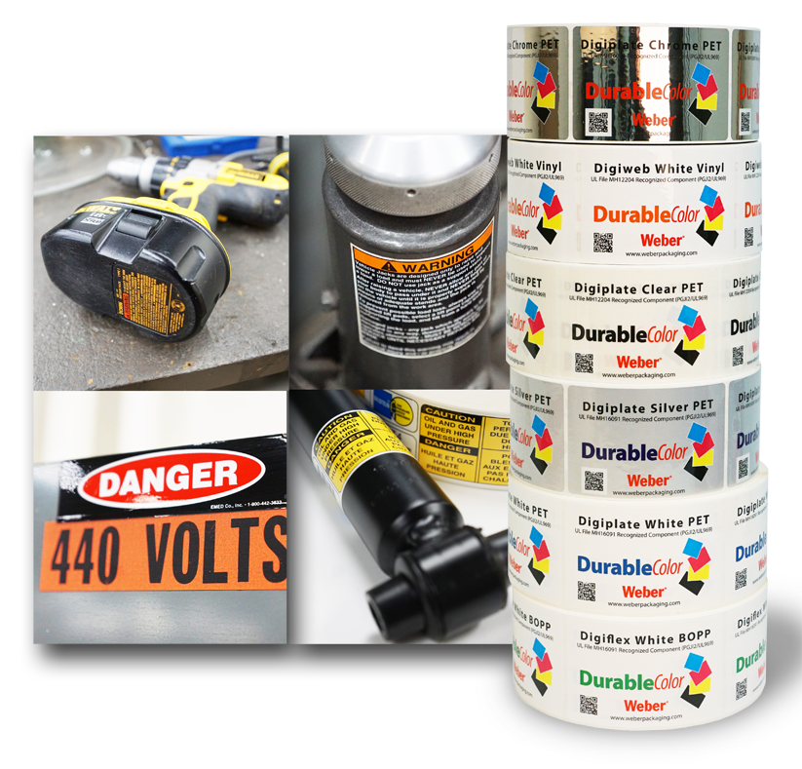
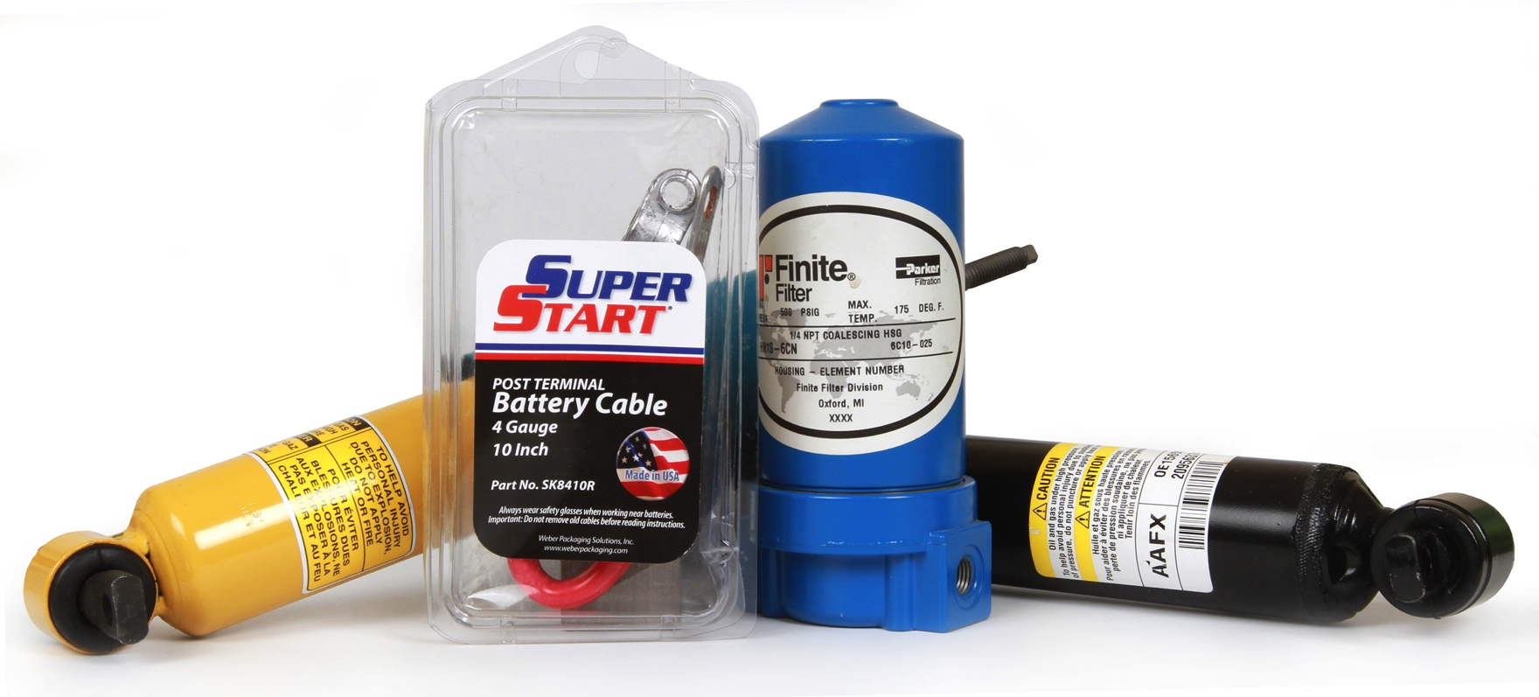
Durable Goods Labels
Heavy-duty labels for harsh environments
Weber Durable Labels
Weber's line of durable film label materials are specifically designed to maximize long term performance of labels on products that need heavy-duty labels that last.
A durable label is intended to remain with a durable good throughout the product’s life and must withstand possible hostile environments such as exposures to chemicals, extreme temperatures, or UV light. Additionally, the label often must be recognized by UL as being a component itself of the durable good.
Durable products, such as tools, automotive parts, warning signs, consumer electronics, industrial machinery and more need labels that will withstand repeated use, abuse and harsh weather.
Weber Packaging Solutions
Heavy-duty labels that look good.
+032459733

Slide 17
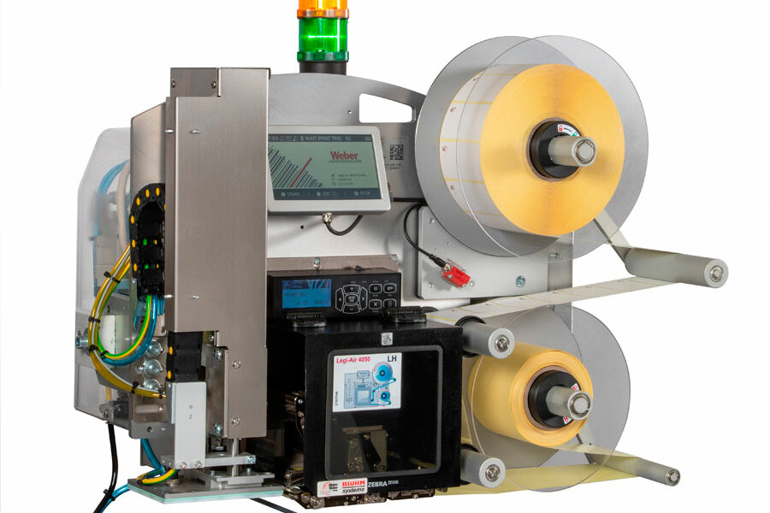
Weber LA4050E Tamp-Blow
Label Printer Applicator
Weber LA4050E Tamp-Blow
• Choose of 203, 300, or 600-dpi print engines
• Labeling speeds up to 400 mm/second
• Touchscreen HMI
• Labeling accuracy to ±0.5mm
• RFID capability available
• Non-Touch tamp-blow label application
24/7
Reliable
LCD HMI
1 to 1 Media

Slide 18
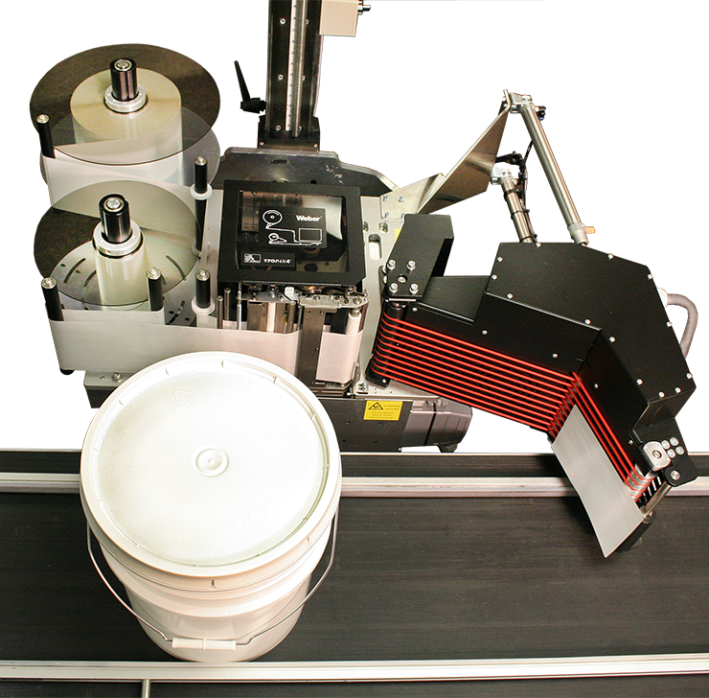
Model 5300 Pail/Drum
Wrap-Around Label Printer Applicator
Weber Model 5300 Pail/Drum
• Choose of 203-, 300-, or 600-dpi print engines
• Print & applies labels up to 180mm x 350mm
• LCD display HMI provides easy access to
all adjustments
• Labels up to 30 products/minute
• Applies labels to large cylindrical products
• Wrap-around wipe-on label application
24/7
Reliable
LCD HMI
1 to 1 Media

Slide 19
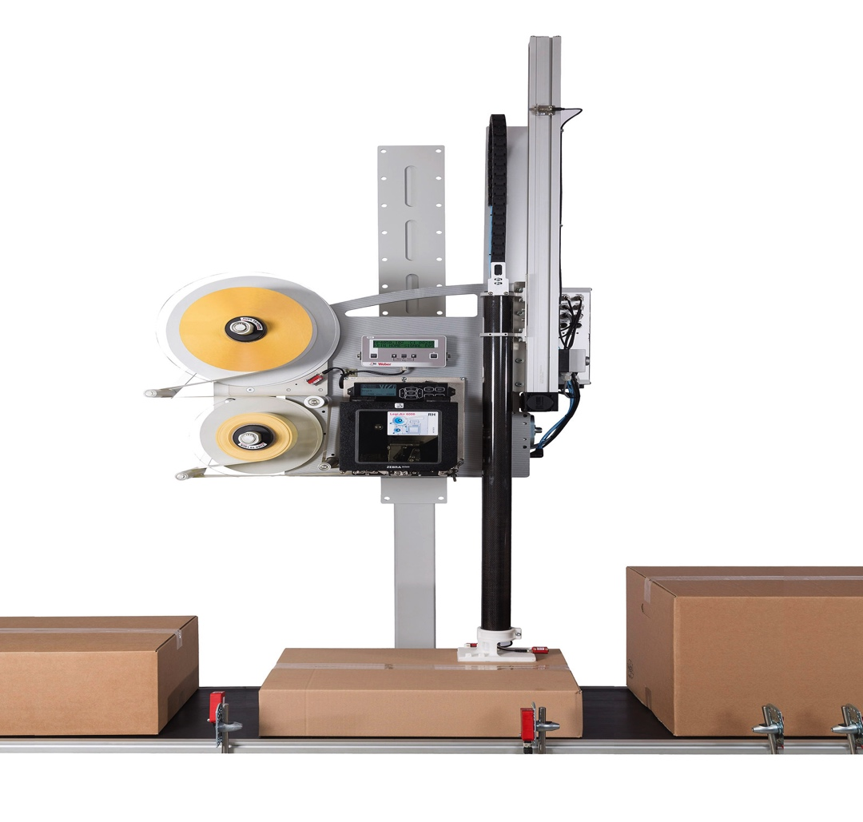
Weber LA-6000
Variable-Height Label Printer Applicator
Weber LA-6000
• Choose from Zebra or Sato print engines
• Prints & applies labels up to 120mm x 200mm
• Non-contact tamp-blow label application
• Labeling accuracy to ±0.5mm
• High-speed, variable-height labeling
• Up to 3000 labels per hour
• Servo motor driven dispensing applicator
and carbon fiber construction
• Larger 350mm diameter label reel unwind
High-speed
Reliable
Modular
Versatile

Slide 20
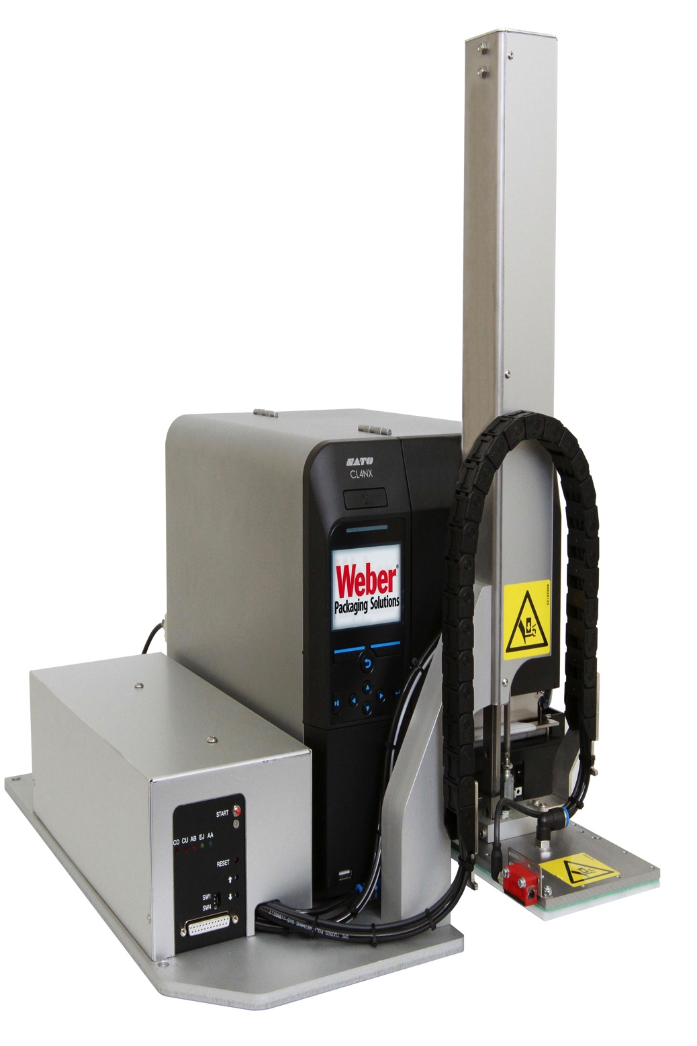
Weber LA-2050
Low-Cost Label Printer Applicator
Weber LA-2050
• Uses Sato CLNX label printer
• Prints & applies labels up to 120mm x 160mm
• Non-contact tamp-blow label application
• Labeling accuracy to ±0.5mm
• Numerous I/Os including USB, LAN, Bluetooth
• Compact unit can be mounted using a jig
fixture on a stand or on a production line
• Variable stroke and tamp sensor
Economical
Reliable
Modular
Versatile

Slide 21
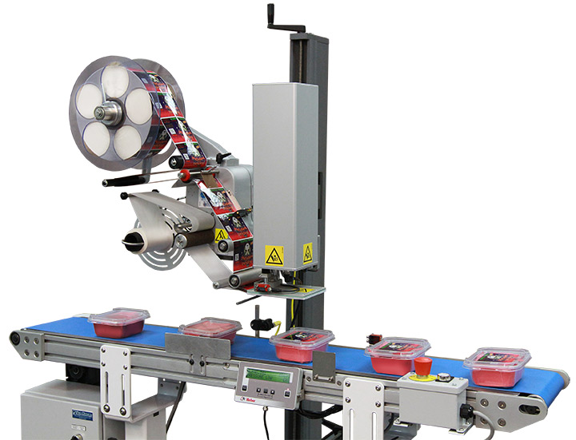
Alpha Tamp-Blow
Label Applicator
Weber Alpha Tamp-Blow
• Applies labels up to 150mm wide
• Labeling speeds up to 50 m/minute
• LCD display HMI provides easy access to
all adjustments
• Labeling accuracy to ±0.5mm
• USB connectivity
Economical
Reliable
LCD HMI
Adjustable

Slide 22
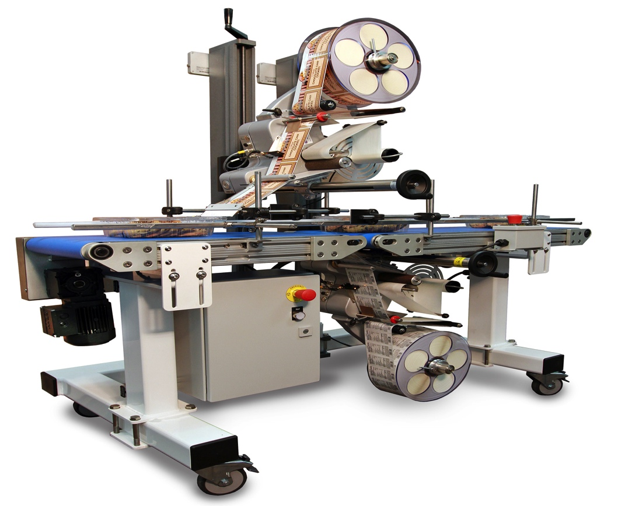
Alpha Top-Bottom
Top & Bottom Label Applicator
Weber Alpha Top-Bottom
• Applies labels up to 300mm wide
• Labeling speeds up to 50 m/minute
• LCD display HMI provides easy access to
all adjustments
• Labeling accuracy to ±0.5mm
• Labels top and bottom of containers accurately using 2 Alpha Compacts
2-Sided
Reliable
LCD HMI
Adjustable

Slide 23
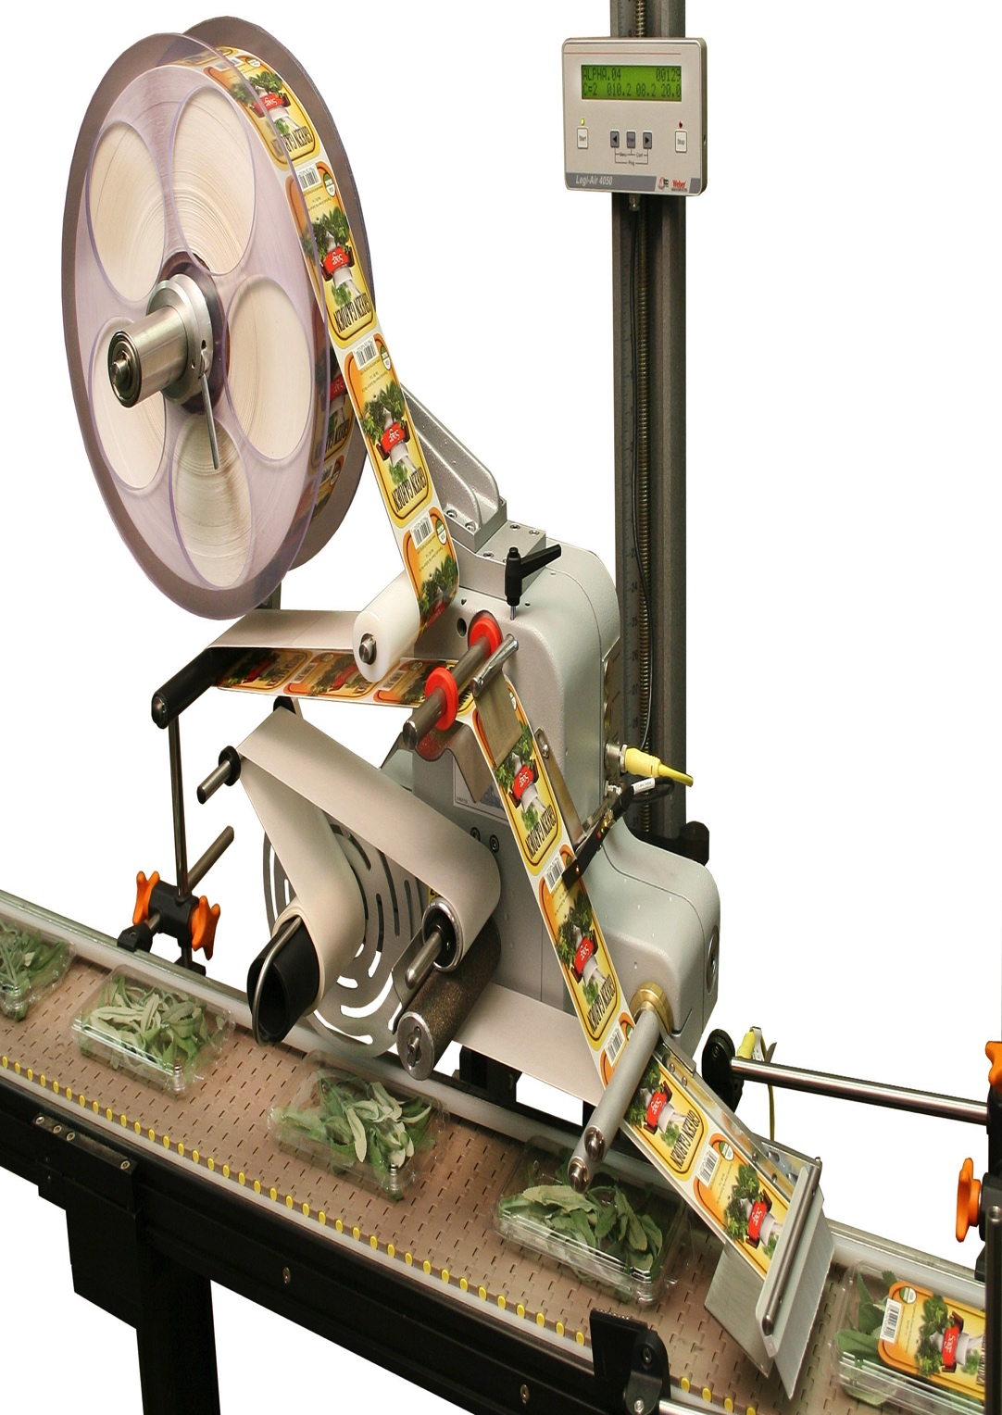
Alpha Compact
Label Applicator
Weber Alpha Compact
• Applies labels up to 300mm wide
• Labeling speeds up to 164 m/minute
• LCD display HMI provides easy access to
all adjustments
• Labeling accuracy to ±0.5mm
• USB connectivity
Economical
Reliable
LCD HMI
Adjustable

Slide 24
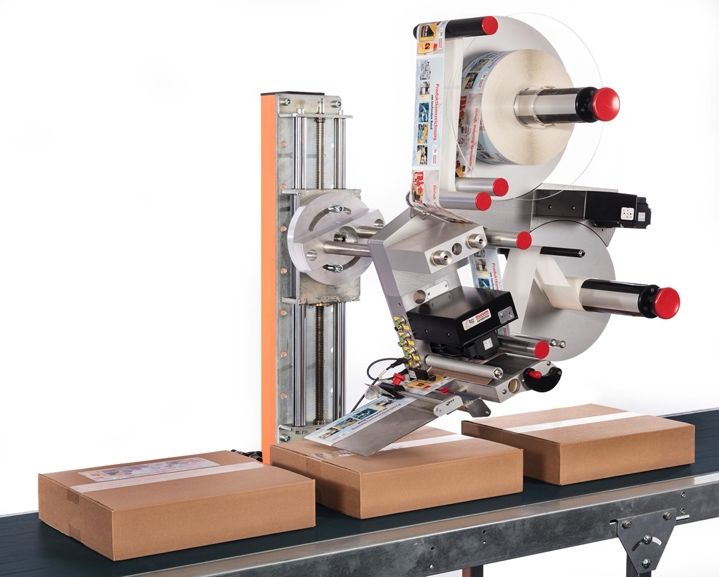
Alpha HSM
High-Speed Label Applicator
Weber Alpha HSM
• Applies labels up to 320mm wide
• Labeling speeds up to 150 m/minute
• Modular design can be configured in
multiple styles
• Labeling accuracy to ±0.3mm
• Mechanical or servo motor unwind/rewind
units for faster application and better
flexibility
Modular
Reliable
High-speed
Servo

Slide 25
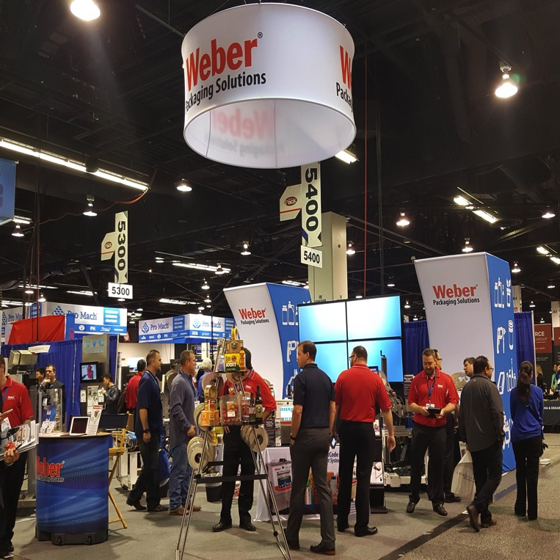
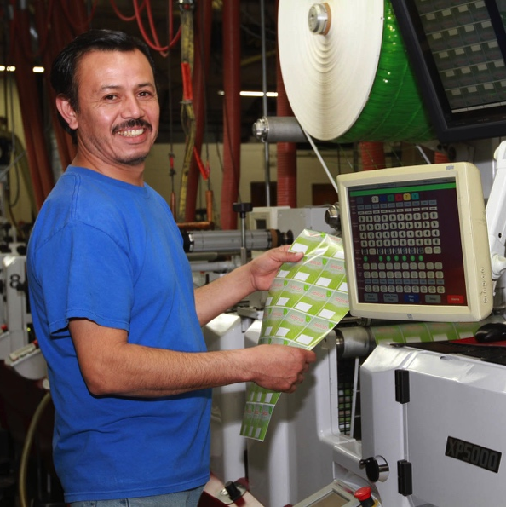
About Weber
A leading innovator in the design, engineering, manufacture and supply of high-performance labels, labeling systems and
thermal ink jet systems.
A Long Journey
Originally founded in 1932 as Weber Addressing Machine Company, we have grown along with the ever-changing technology of labeling & coding.
Over the years, Weber has
become an international leader in producing labeling and coding solutions we could never have imagined so long ago.

Slide 26

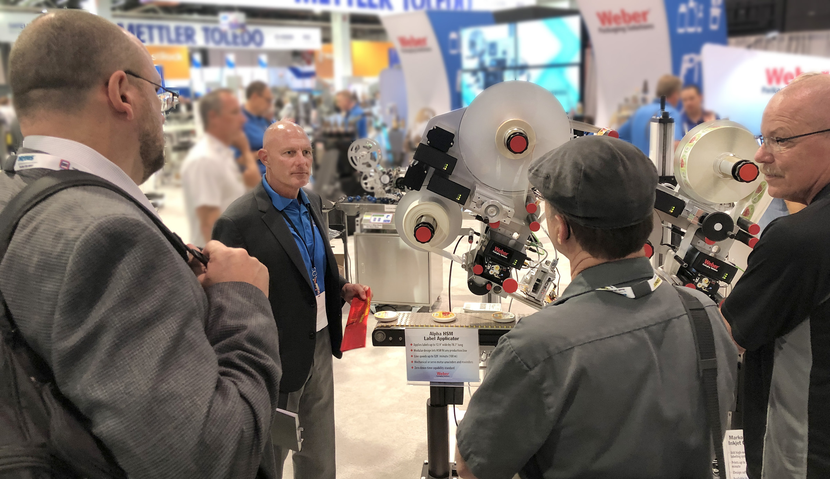
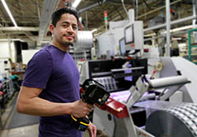
Mission Statement
Our promise to you.
We Identify Your World
DEDICATION & INNOVATION
01
For almost 90 years, we have been bringing innovative products to our customers and helping them solve their labeling and coding problems.
01
Our Success comes from helping our customers grow.
02
02
Our Commitment is to bring technologies to market that improve packaging automation, product identification and brand recognition.
03
Our Team is agile, creative, responsive and conscientious toward our customers, our community and our environment.
03

Slide 27




Certifications & Awards
Providing the best products and services for our customers
GS1 UK Partner
Zebra Premier Partner
Weber is a GS1 Global Solutions Partner for Barcoding Technology
As a Zebra Premium Partner, Weber can offer more value to their customers on Zebra products
ISO Registered
BRC Certification
Weber’s products and processes are certified to meet ISO 9001: 2015 and ISO 14001 Standards
Weber is certified to produce Flexible Packaging to BRC/IOP Standards

Slide 28






Follow Weber
Check out our Social Media to get the latest information on Labeling & Coding.
Twitter
FaceBook
LinkedIn
Weber shares industry information
Info about Weber Corporate activities
Corporate information and professional connections
YouTube
Pinterest
Weber Blog
Watch equipment demos and product videos
A visual gallery of industry interests
Articles about products for the packaging
industry

Slide 29
Contact Weber
We are there for you. Give us a call.
Patrick Hughes – General Manager (UK & Ireland)
Weber Packaging Solutions UK & Ireland
Macmerry Industrial Estate
Tranent
East Lothian
EH33 1HD
Scotland
Kilcannon Industrial Estate
Old Dublin Road
Enniscorthy
Wexford Y21 E281
Ireland
EMAIL:
patrick.hughes@weber.co.uk
PHONE:
+44 7779 804401
WEB SITE:
www.weber.co.uk

