Slide 1
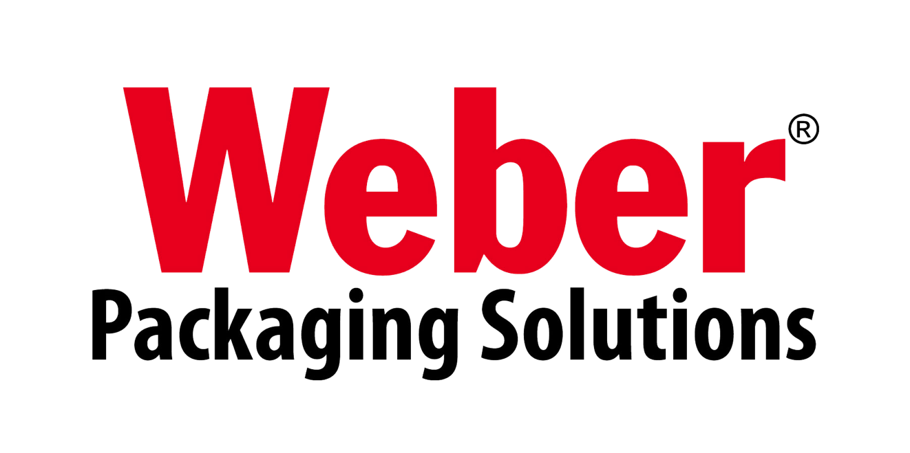
Innovations in Labeling & Coding Solutions
+032459733

Slide 2
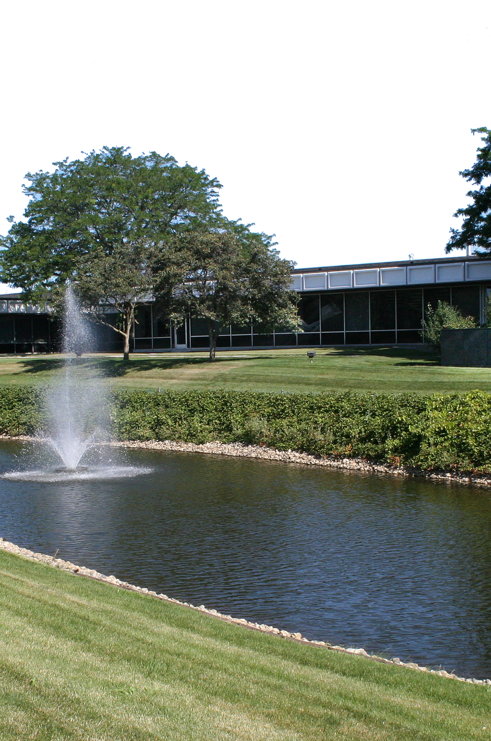
About Weber
A leader in the packaging world for over 90 years.
Labels
Weber prints millions of labels annually for food, beverage, life sciences, chemical industries and more.
Labeling Systems
Weber designs & manufactures a wide range of label applicators and print-apply systems.
Ink Jet Systems
Our Thermal ink jet coders are reliable, easy-to-use, and economical to run.
Nationwide Service
Our direct service team will work with you to keep your equipment operating at optimum efficiency.
www.weber.co.uk
Weber Packaging Solutions
Arlington Heights, Illinois, World Headquarters
+032459733

Slide 3
Worldwide Weber
Providing global coverage for innovative labeling and coding products.
Canada
Weber Marking
Systems Canada
Germany
Weber Marking Systems GmbH
USA
Weber Packaging
Solutions
Ireland
& UK
Weber Packaging Solutions UK & Ireland
Thailand
Weber Marking Systems Thailand
Australia
Peacock Bros. Pty.
Weber manufacturing facilities worldwide

Slide 4












Our Valued Clients
Providing Innovative Labelling Solutions to Global Companies
Canada
Weber Packaging UK
Weber Marking Thailand

Slide 5
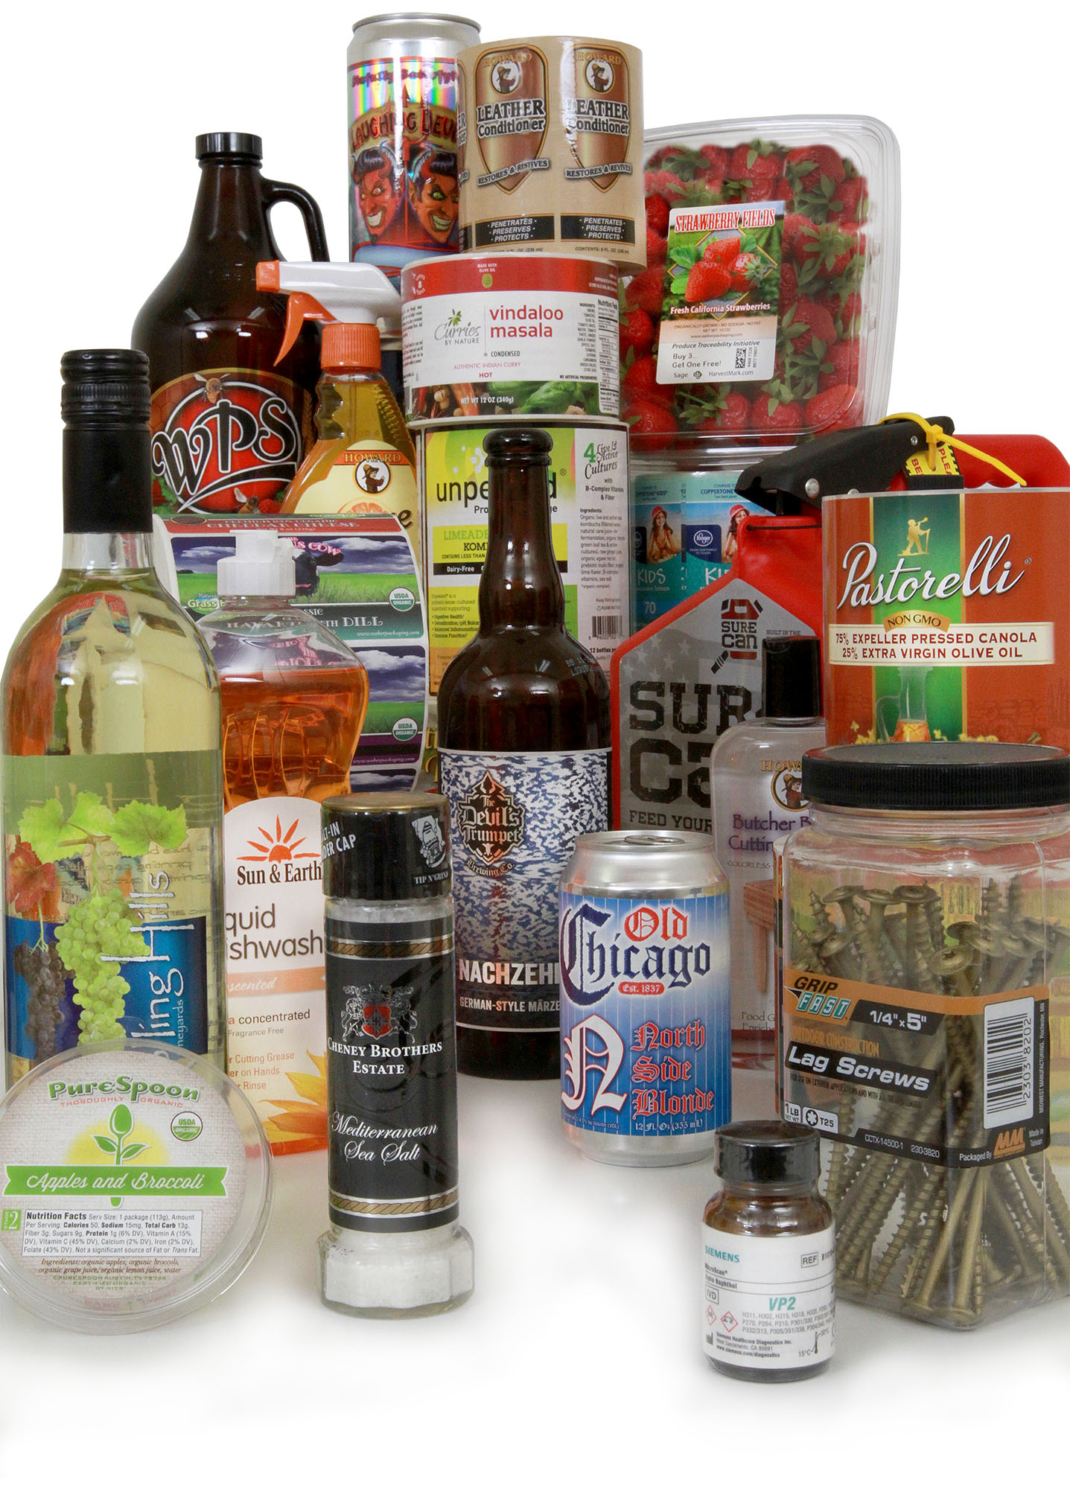
Labels
Custom labels, blank labels, RFID labels & more
Weber Labels
Weber Packaging Solutions manufacture a very broad line of labels and tags at our 20,000-square-foot manufacturing facility.
With over 10 Mark Andy flexographic and digital label presses under one roof, we are able to select the most productive printing technology for a particular order. These high-speed presses print labels up to ten colors, including services such as laminating and embossing
Weber also offers over one hundred combinations of paper and film label stocks partnered with numerous adhesives to create labels that can be perfectly matched to a specific application.
Weber Packaging Solutions
Custom Labels for any market or category.
+032459733

Slide 6
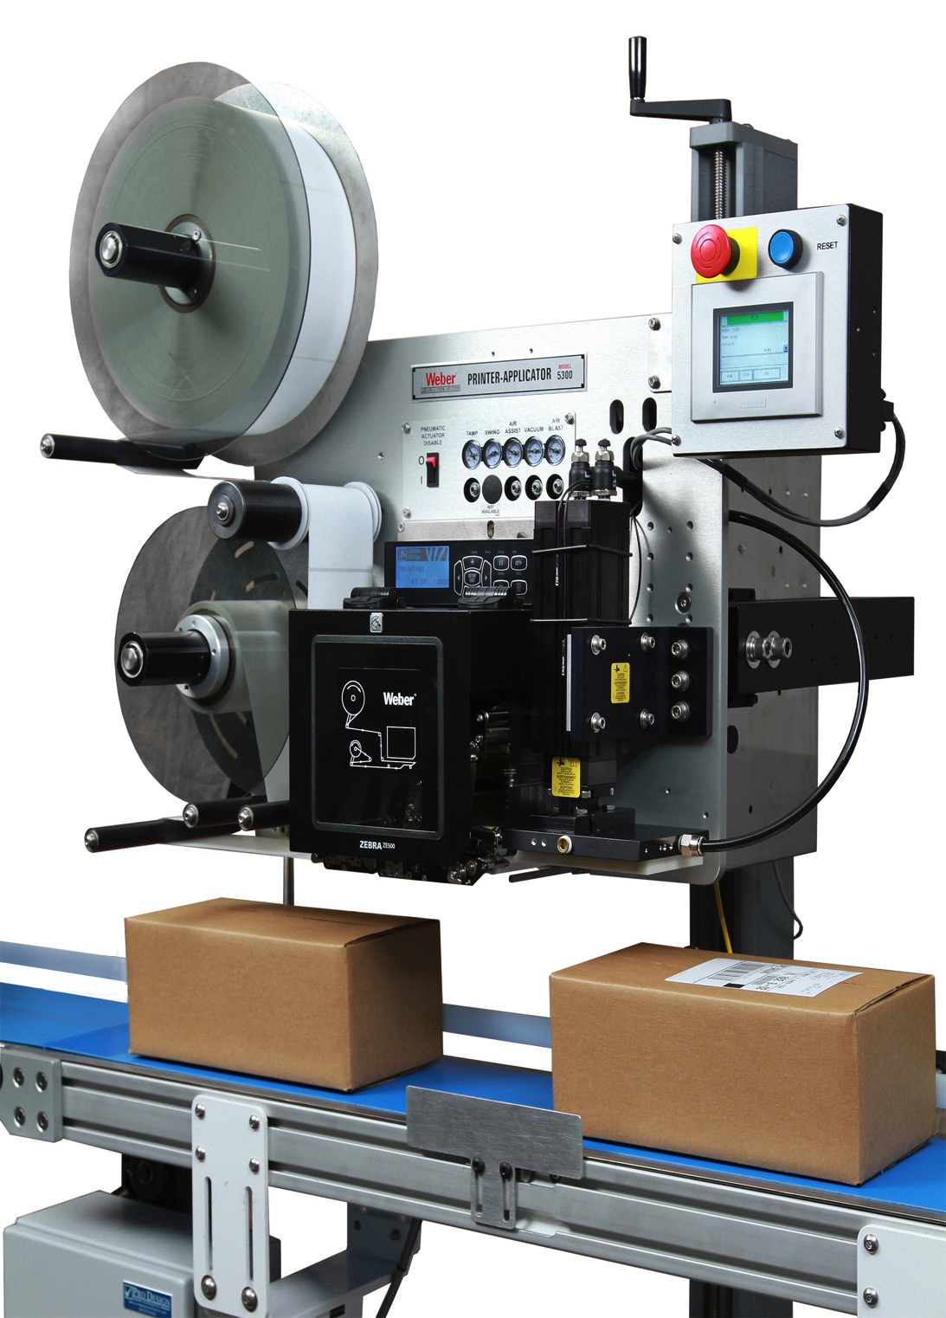
Labeling Systems
Label Printer-Applicators
Weber Print-Apply Systems
Weber manufacture and design a variety of label printer-applicators to fit every industry and application. We can customize a system to fit into your current production line or act as a stand-alone unit for semi-automatic feeding.
The major benefits of print-apply systems include their ability to:
• Eliminate the expense & inconvenience of preprinted labels
• Eliminate label obsolescence
• Reduce labor costs
• Provide faster, more accurate labeling
These sturdy, self-contained units combine a high-density thermal/thermal-transfer label printer with an automatic label applicator to simultaneously print and apply pressure-sensitive labels to the top, bottom or side of products along the conveyor line.
Weber Packaging Solutions
Reliable labeling systems built to last.
+032459733

Slide 7
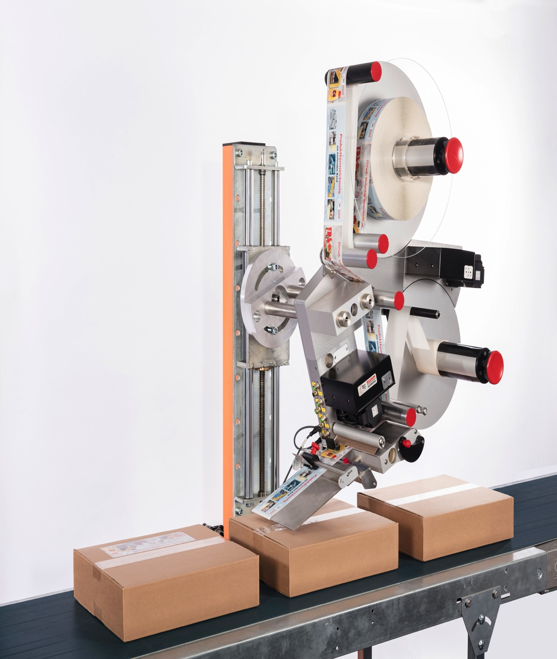
Labeling Systems
Label Applicators
Weber Label Application Systems
Weber offer a complete line of automatic label applicators that can rapidly apply preprinted pressure-sensitive labels to all types of products and packages.
• High-speed application rates programmable up to 6,000
linear inches of label web/min.
• Advanced stepper-motor or servo-motor technology and
peel-tip sensing
• Gentle-contact (wipe-on) or non-contact (tamp-blow or
air-blow) methods of application
• Exceptional placement accuracy to ±0.03”
• Easy maintenance and unsupervised operation functions
• Low-volume and hand-apply systems for economical
labeling
Weber Packaging Solutions
Accurate, high-speed labeling.
+032459733

Slide 8
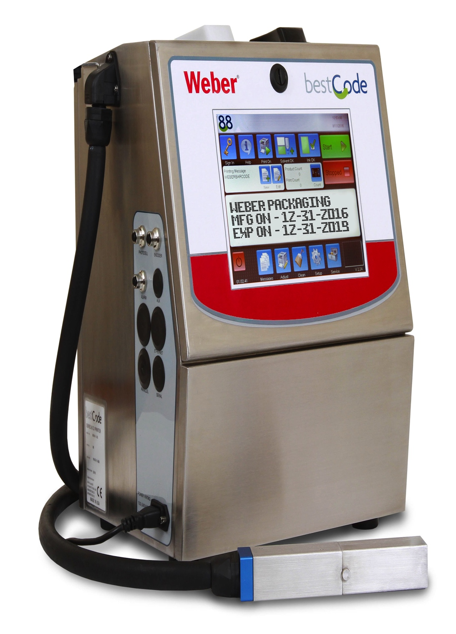
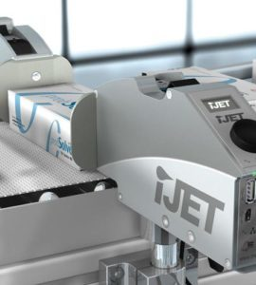
Ink Jet Systems
Reliable Ink Jet Coders
Weber TIJ Coders
Weber’s Industrial Marking and Coding Systems print high resolution date codes, lot codes, 2D Barcodes and other identifying marks and codes on industrial and consumer goods to ensure product traceability.
Under our Markoprint Brand we provide a complete range of small character printing systems that print high-speed, reliable marks and codes on a wide range of substrates including plastic, glass, paper and more.
A wide selection of models are available to fit your application, from high-speed multi-line coders to the entry-level economically-priced X1 Jet System.
Weber Packaging Solutions
A wide range of Thermal ink jet solutions.
+032459733

Slide 9
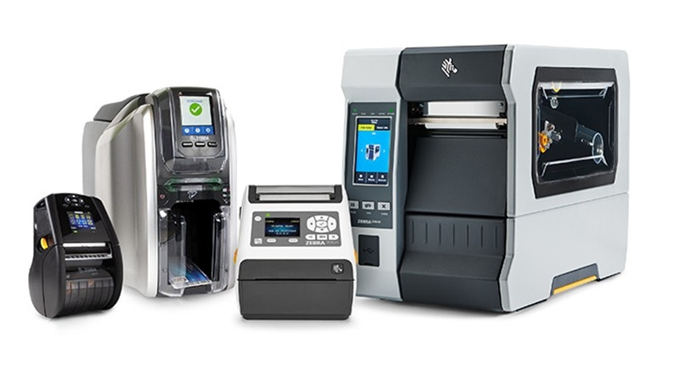
Desktop Printers
Barcode Printing Solutions
Weber Desktop / Mobile Printer Solutions
Weber supply a wide range of Barcode Label and Tag Printers from Industry Leaders such as Zebra, Sato, and TSC. We can supply a wide range of solutions from narrow web tag and wristband printers for patient ID care to wider web printers for logistics and manufacturing.
Our industrial printers are designed for harsh and demanding environments. With rugged durability and future-proof adaptability, our user-friendly barcode label and RFID printers are designed to provide 24/7 reliability and ideal for your high- to mid-volume applications.
A wide selection of models are available to fit your application, including bespoke Semi Automatic Label Applications.
Weber Packaging Solutions
A wide range of Barcode Printing Solutions.
+032459733

Slide 10
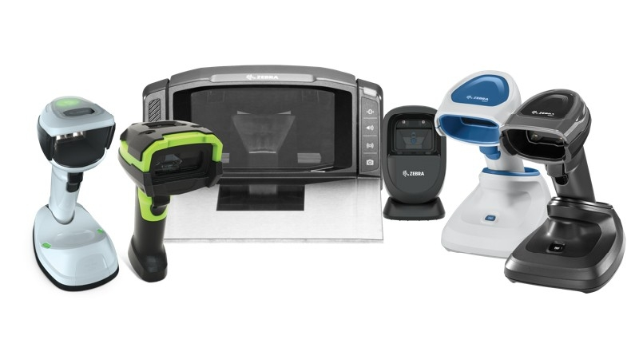
Barcode Scanners
Barcode Printing Solutions
Weber Desktop / Mobile Data Capture Solutions
Weber supply a wide range of Barcode Scanners and mobile Data Capture Devices from Industry Leaders such as Zebra, Datalogic, and Sick. We can supply a wide range of solutions from desktop based scanning kiosks to mobile and wireless Handheld Barcode Scanning Solutions.
Our industrial scanners are designed for harsh and demanding environments and can be used with a suite of software, apps and utilities to accelerate productivity and improve decision making in your organisation.
In conjunction with our Industrial Automatic Labelling Systems we provide an Industrial Range of Scanners for automatic identification of Products and Barcode Scanning at the point of Label Application.
Weber Packaging Solutions
A wide range of Barcode Printing Solutions.
+032459733

Slide 11
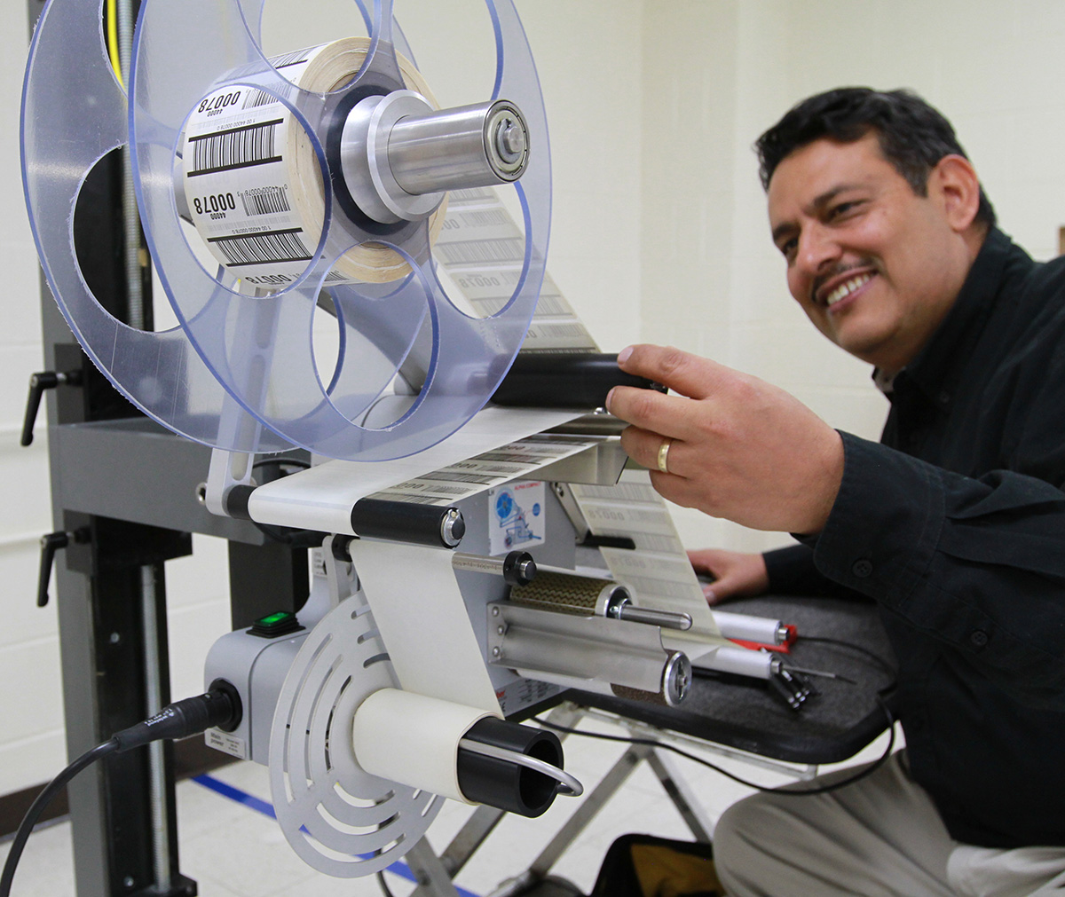

Service & Support
Get the help you need fast.
Weber Technical Services and Support
Our Technical Support Services provide our customers with whole of life technology Service & Support which provide the following benefits
Increased efficiencies through machine Uptime
Ensure Print Quality in your Identification Processes
Focus company resources on Core Business
Manage Peak Production Demands efficiently
Reduce Business Continuity Risk
Reduction of Machine Downtime Costs
Weber Packaging Solutions
Nationwide direct service organization.
+032459733

Slide 12
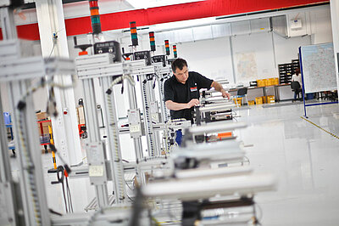
Whole of Life Service and Support
Get the help you need fast.
Pre Sales Technical Support – Aftermarket & Warranty
Technical Site Surveys
Trial / Proof of Concept & Demonstrations
Device Configuration
Installation & Commissioning Services
Operator / Engineer Training
Helpdesk & Customer Technical Support
Field Support Services
Preventative Maintenance
Warranty Management
Workshop Repairs
Parts Inventory Management
Weber Packaging Solutions
Nationwide direct service organization.
+032459733

Slide 13
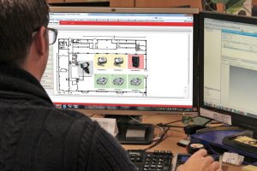
UK & Ireland Support Coverage
Get the help you need fast.
Weber UK & Ireland Technical Resources
Parts Warehouses in UK & Ireland
Training Centre based in Edinburgh
Workshop Repair Centres in UK & Ireland
Forward Stock Locations throughout UK
Commissioning Centre based in Edinburgh
Demonstration Centre based in Edinburgh
Permanently Employed Service Engineers
Mechanical and Software Engineer Skillset
Certified Print Engine Repair Specialist
GPS Tracking and Location monitoring
Weber Packaging Solutions
Nationwide direct service organization.
+032459733

Slide 14
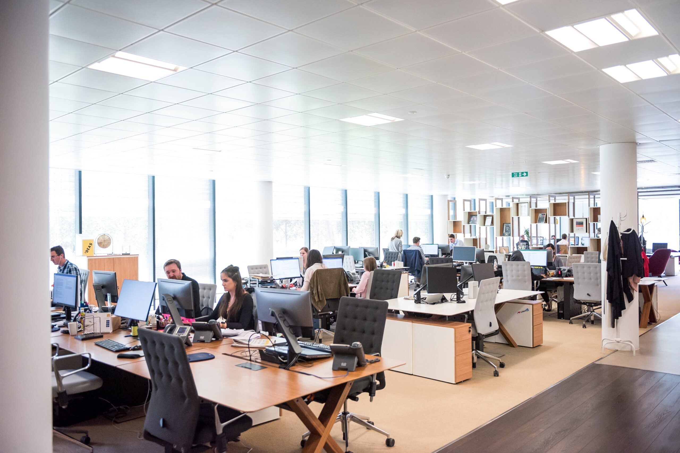
Pre Sales Services
Get the help you need fast.
Our Pre Sales Support Services provide our customers with a professional approach to automatic identification and automation projects
Technical Site Surveys
Product Demonstrations
Proof of Concept Applications
Barcoding Consultancy
Application Walkthrough
Project Management
Weber Packaging Solutions
Nationwide direct service organization.
+032459733

Slide 15
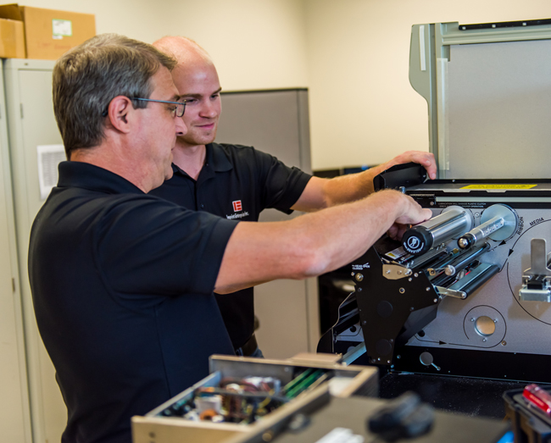
Technical Support Services
Get the help you need fast.
Weber Technical Services and Support
Our Technical Support Services provide our customers with product enablement for both small and large scale projects.
Device Configuration
Project Commissioning
Customer Installations
Product Rollouts
Operator Training
Technical / Engineer Training
Specialist Installs
Software Design & Implementation
Product Upgrades
Weber Packaging Solutions
Nationwide direct service organization.
+032459733

Slide 16
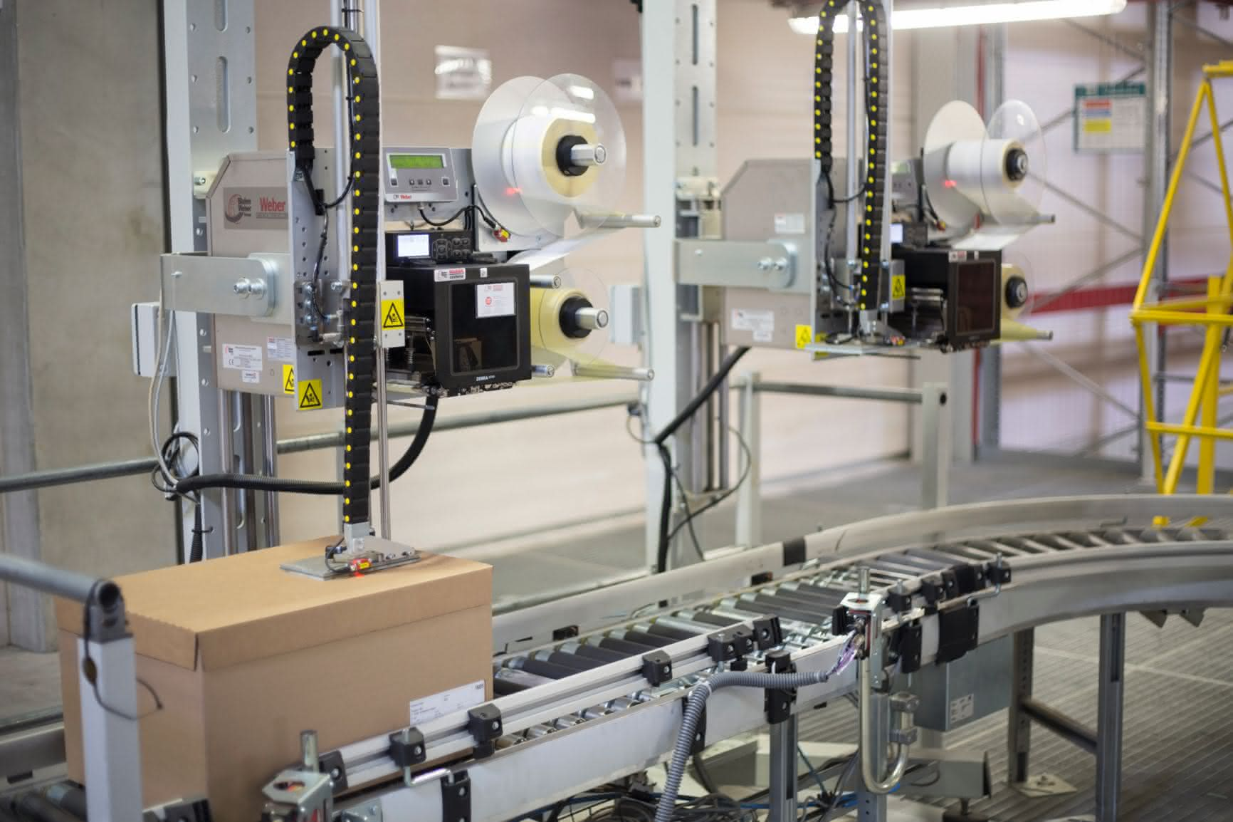
Maintenance Support Services
Get the help you need fast.
Weber Maintenance Support
Weber provide a wide range of Maintenance Repairs and Service Level Agreements to give customers the flexibility to tailor a package to suit their needs.
Planned Preventative Maintenance
Service Contracts; 8hr, Same Day, Next Day
Purchase Call Plans
Blanket Service Level Agreements
Engineer Outsourcing
Emergency On Call Support
24/7 Remote Diagnostics & Support
Module Swappage & Repair Services
Extended Warranties
Weber Packaging Solutions
Nationwide direct service organization.
+032459733

Slide 17
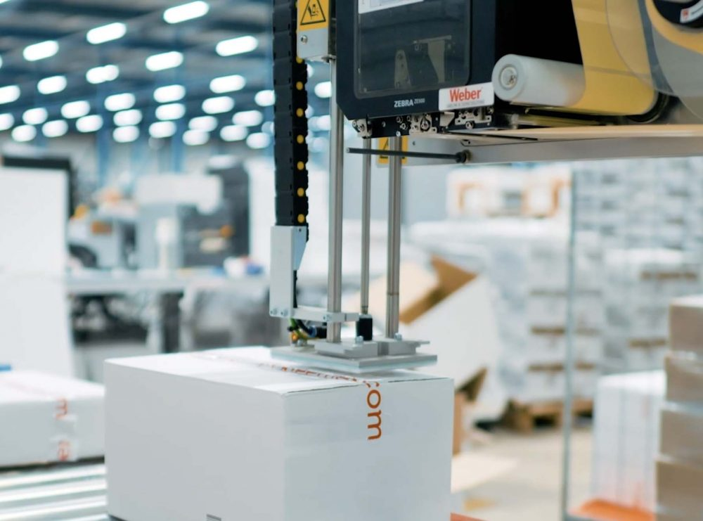
Outsourced Support Services
Get the help you need fast.
Outsource your Maintenance to Weber
Whether you are a Print Systems Supplier or a large scale organization with centralized IT, by outsourcing your Labelling Systems and Coding Systems maintenance to Weber you are enhancing the life of your equipment by relying on 90 years of experience in the Labelling and Auto Identification Industry.
Parts Inventory Management
Periodic Printer Maintenance
Outsourced Technical Helpdesk
Workshop / RMA Services
Product / System Rollouts
Training
24/7 Remote Diagnostics & Support
Upgrades & Product Recalls
Weber Packaging Solutions
Nationwide direct service organization.
+032459733

Slide 18
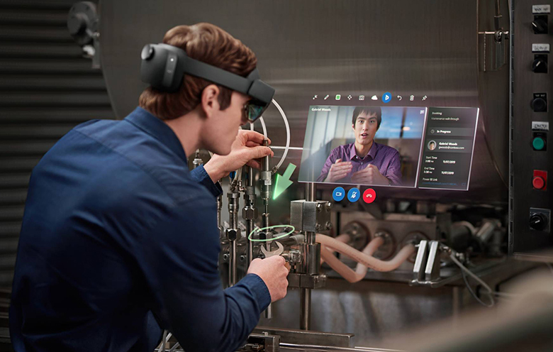
Augmented Reality Support Services
Get the help you need fast.
Always On Support – whenever you need it.
Weber’s Augmented Reality Support Services provide your team with the power to diagnose and repair your Labelling Systems within minutes. Our technical support specialists are available 24/7/365.
Maximise system uptime/availability
Minimise time to diagnose issues
Minimise time to repair Systems
Avoids Costly Call Outs
Support your daily operating goals
No experience required
Weber Packaging Solutions
Nationwide direct service organization.
+032459733

Slide 19
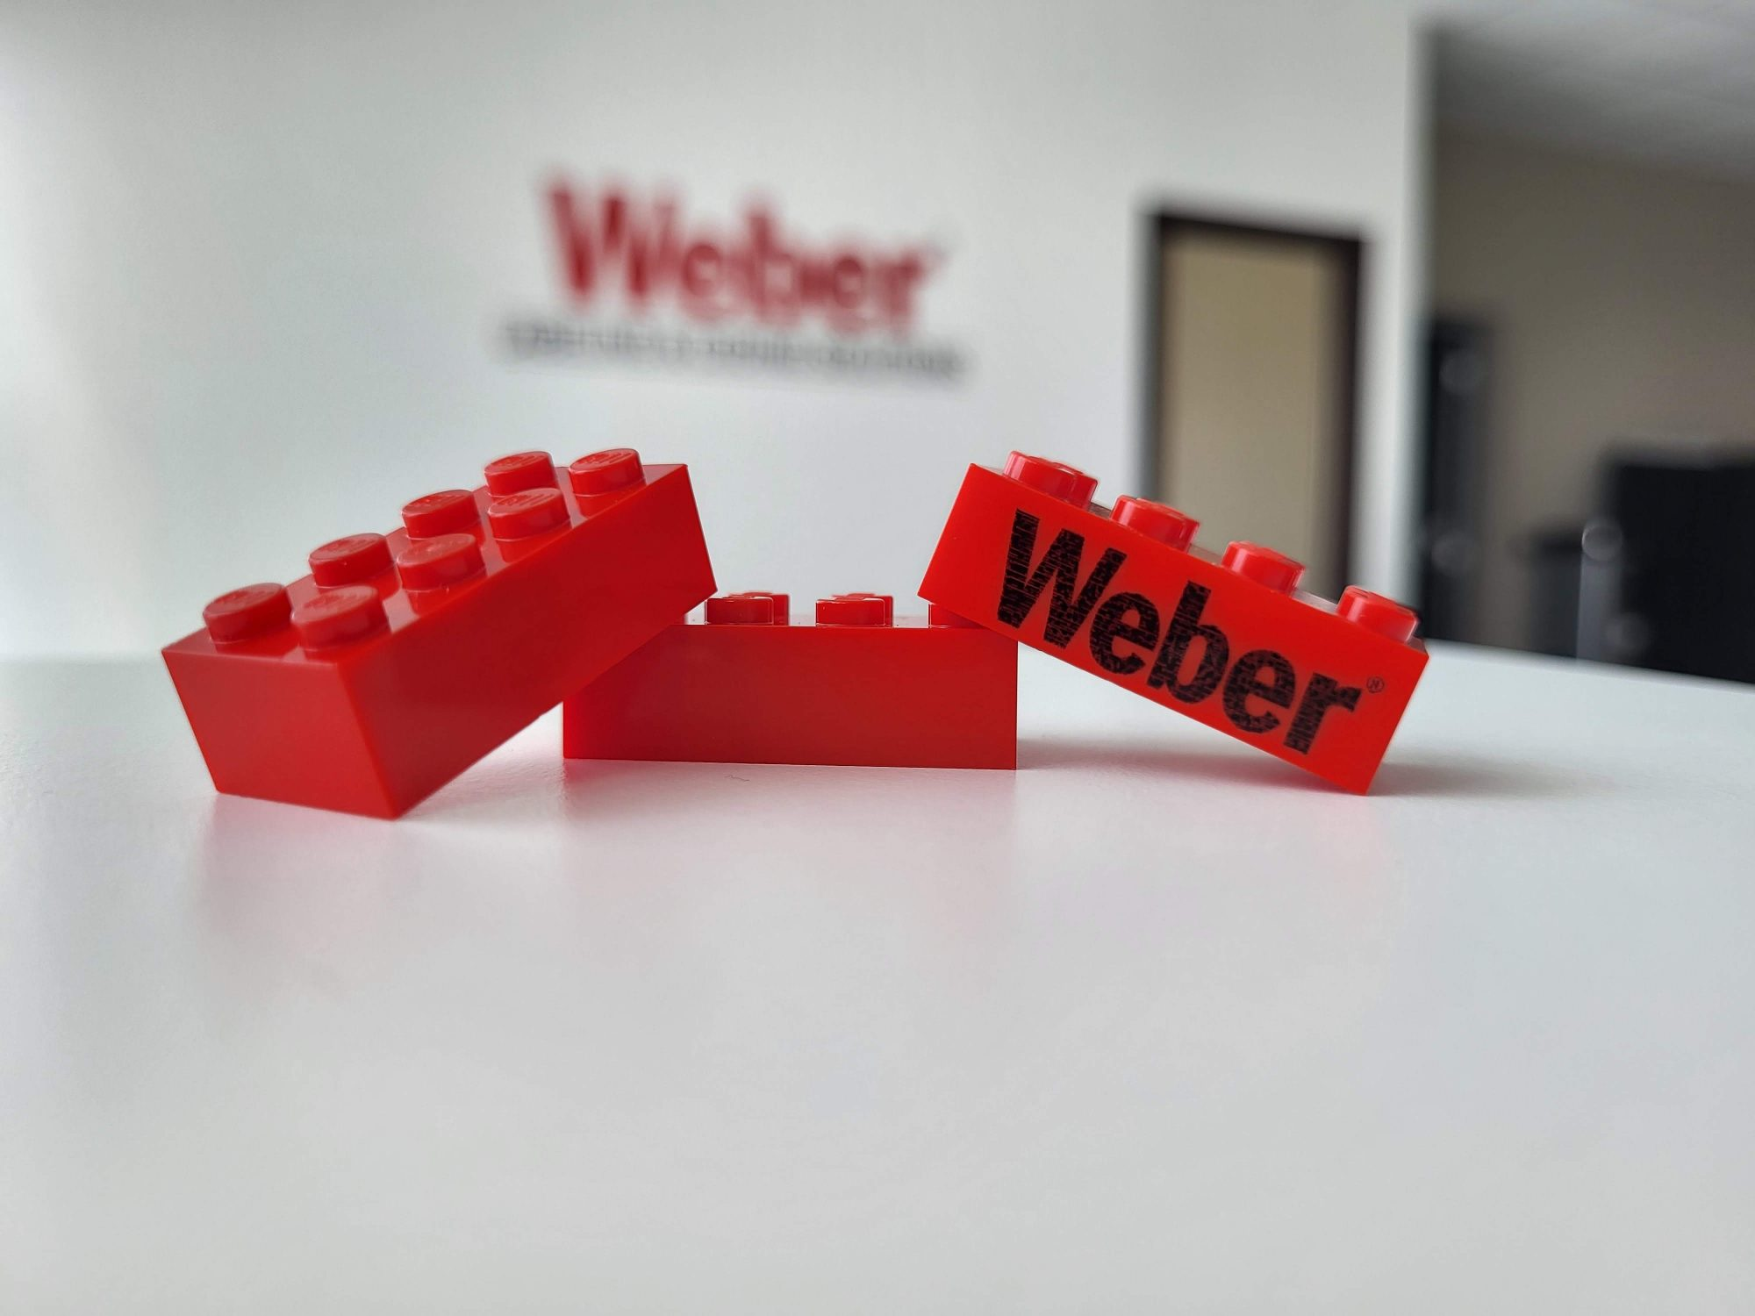
Why Choose Weber
Get the help you need fast.
Labelling System Manufacturer
Direct Service Organisation
Accredited Engineers
90 Years of Labelling Experience
Cost Effective
Extensive Range of Products Supported
Zebra Print Engine Specialist
Flexible Support Options
Transparent Business Model
Weber Packaging Solutions
Nationwide direct service organization.
+032459733

Slide 20
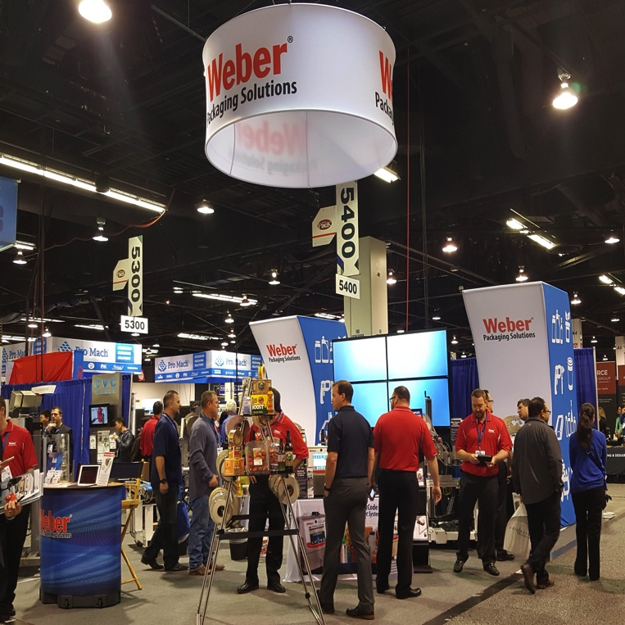
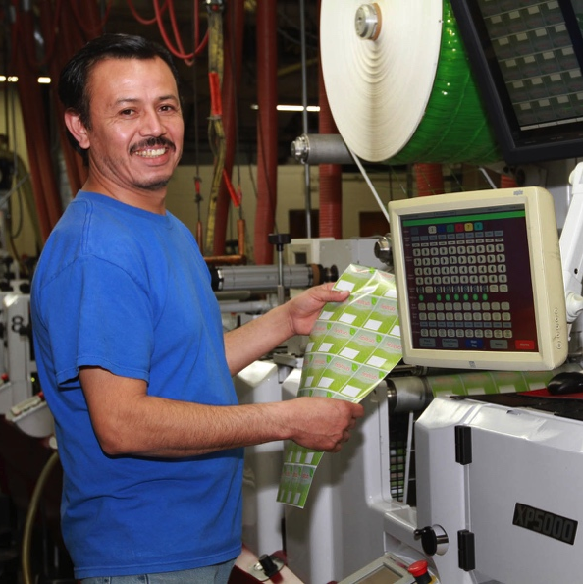
About Weber
A leading innovator in the design, engineering, manufacture and supply of high-performance labels, labeling systems and
thermal ink jet systems.
A Long Journey
Originally founded in 1932 as Weber Addressing Machine Company, we have grown along with the ever-changing technology of labeling & coding.
Over the years, Weber has
become an international leader in producing labeling and coding solutions we could never have imagined so long ago.

Slide 21

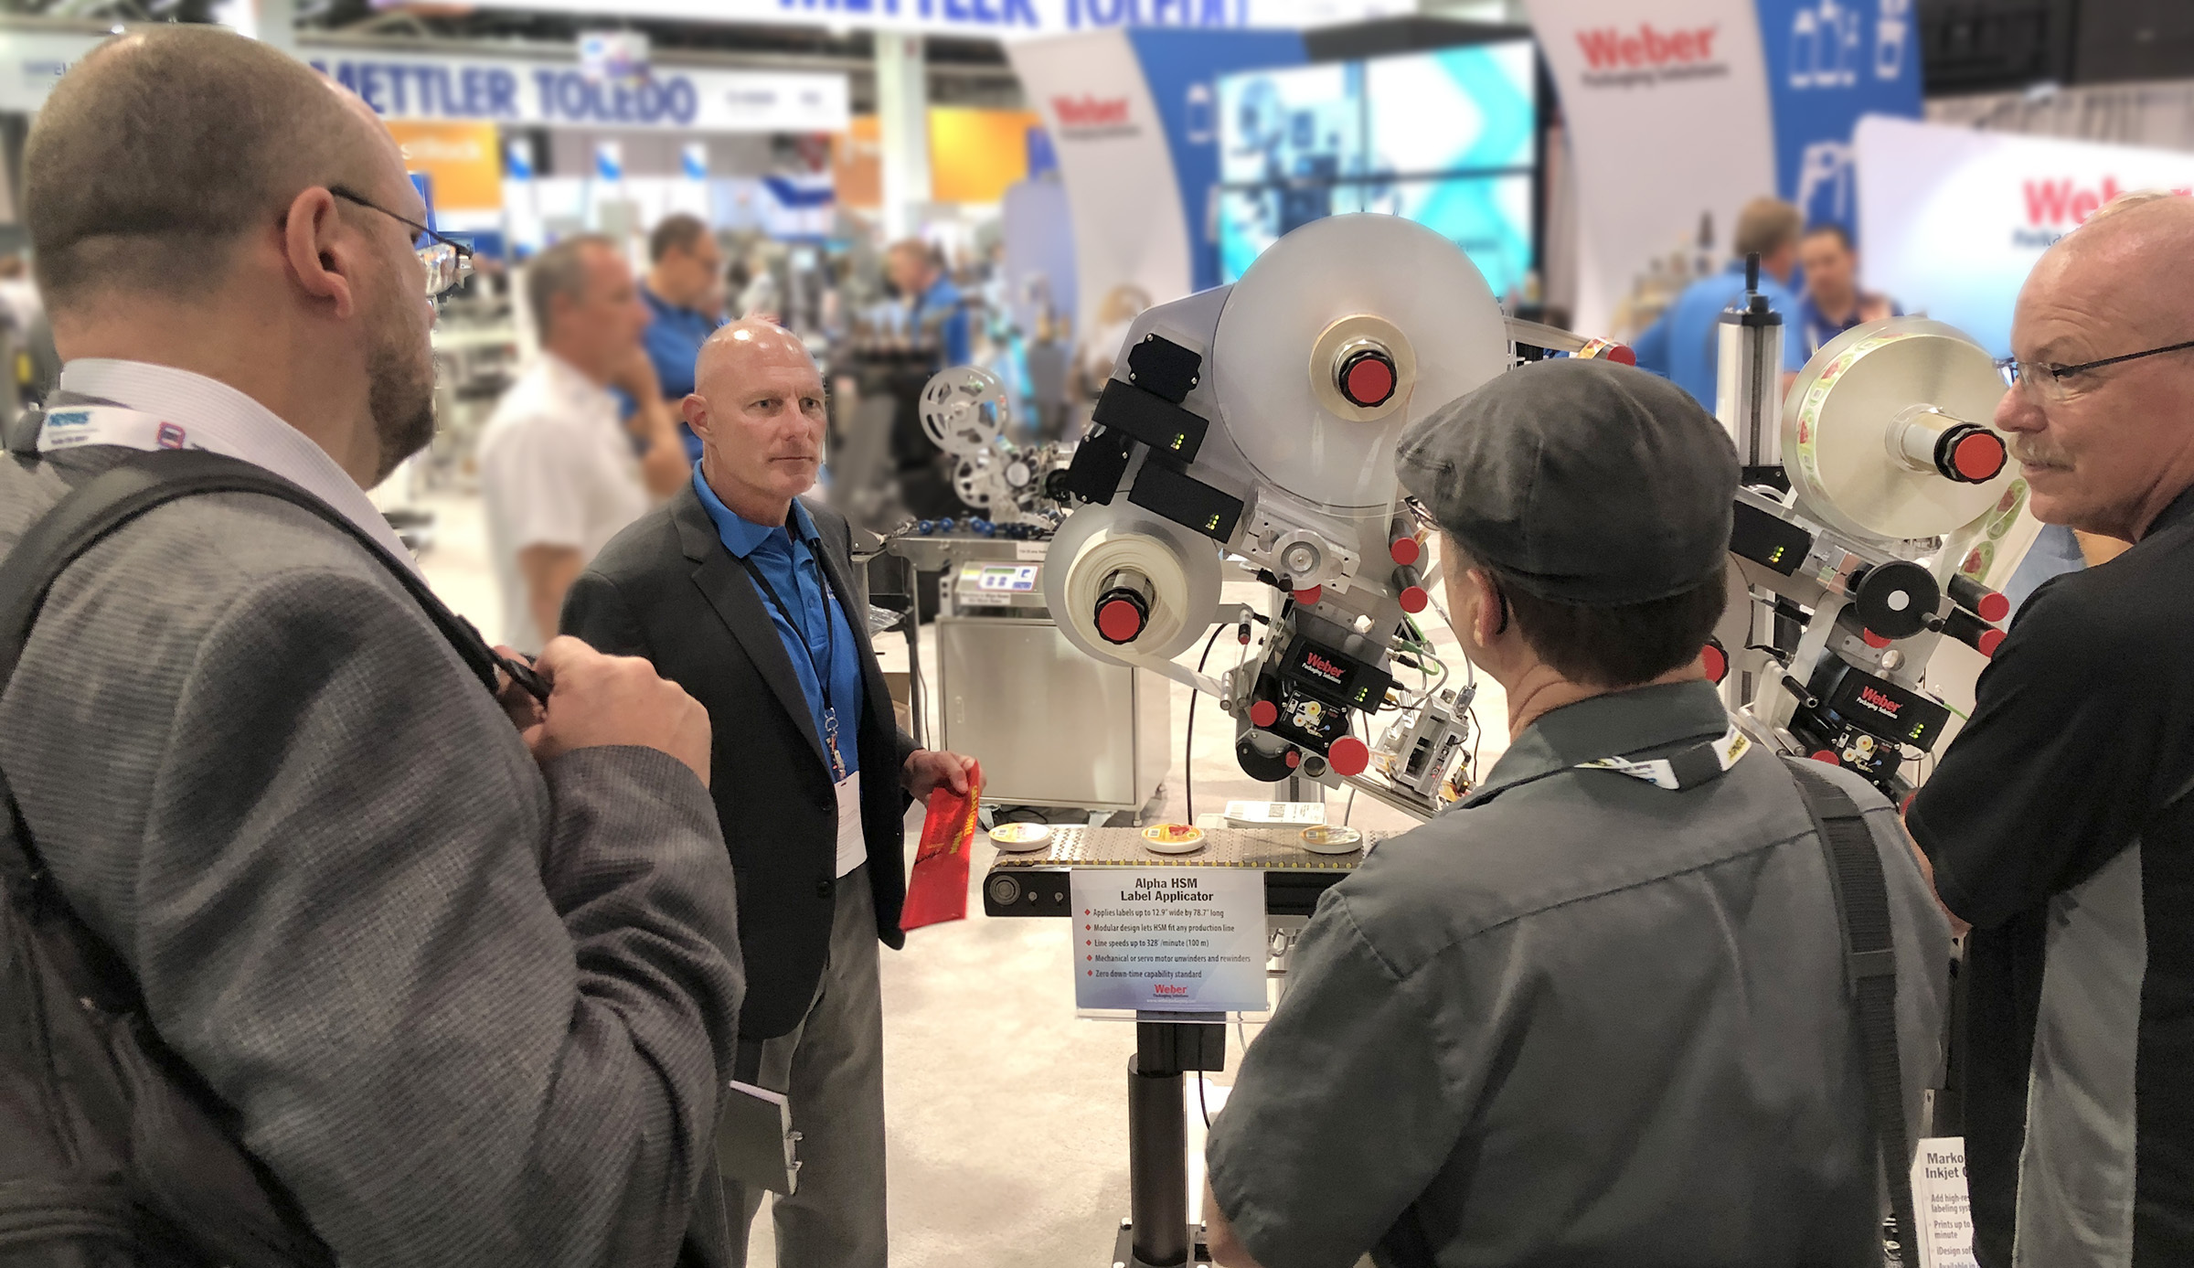
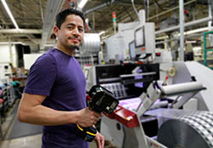
Mission Statement
Our promise to you.
We Identify Your World
DEDICATION & INNOVATION
01
For almost 90 years, we have been bringing innovative products to our customers and helping them solve their labeling and coding problems.
01
Our Success comes from helping our customers grow.
02
02
Our Commitment is to bring technologies to market that improve packaging automation, product identification and brand recognition.
03
Our Team is agile, creative, responsive and conscientious toward our customers, our community and our environment.
03

Slide 22




Certifications & Awards
Providing the best products and services for our customers
GS1 UK Partner
Zebra Premier Partner
Weber is a GS1 Global Solutions Partner for Barcoding Technology
As a Zebra Premium Partner, Weber can offer more value to their customers on Zebra products
ISO Registered
BRC Certification
Weber’s products and processes are certified to meet ISO 9001: 2015 and ISO 14001 Standards
Weber is certified to produce Flexible Packaging to BRC/IOP Standards

Slide 23






Follow Weber
Check out our Social Media to get the latest information on Labeling & Coding.
Twitter
FaceBook
LinkedIn
Weber shares industry information
Info about Weber Corporate activities
Corporate information and professional connections
YouTube
Pinterest
Weber Blog
Watch equipment demos and product videos
A visual gallery of industry interests
Articles about products for the packaging
industry

Slide 24
Contact Weber
We are there for you. Give us a call.
Patrick Hughes – General Manager (UK & Ireland)
Weber Packaging Solutions UK & Ireland
Macmerry Industrial Estate
Tranent
East Lothian
EH33 1HD
Scotland
Kilcannon Industrial Estate
Old Dublin Road
Enniscorthy
Wexford Y21 E281
Ireland
EMAIL:
patrick.hughes@weber.co.uk
PHONE:
+44 7779 804401
WEB SITE:
www.weber.co.uk

